Slide 1
PearsonR_2013_AK
File created on: 1/20/23 12:00:15 PM MST

Slide 2
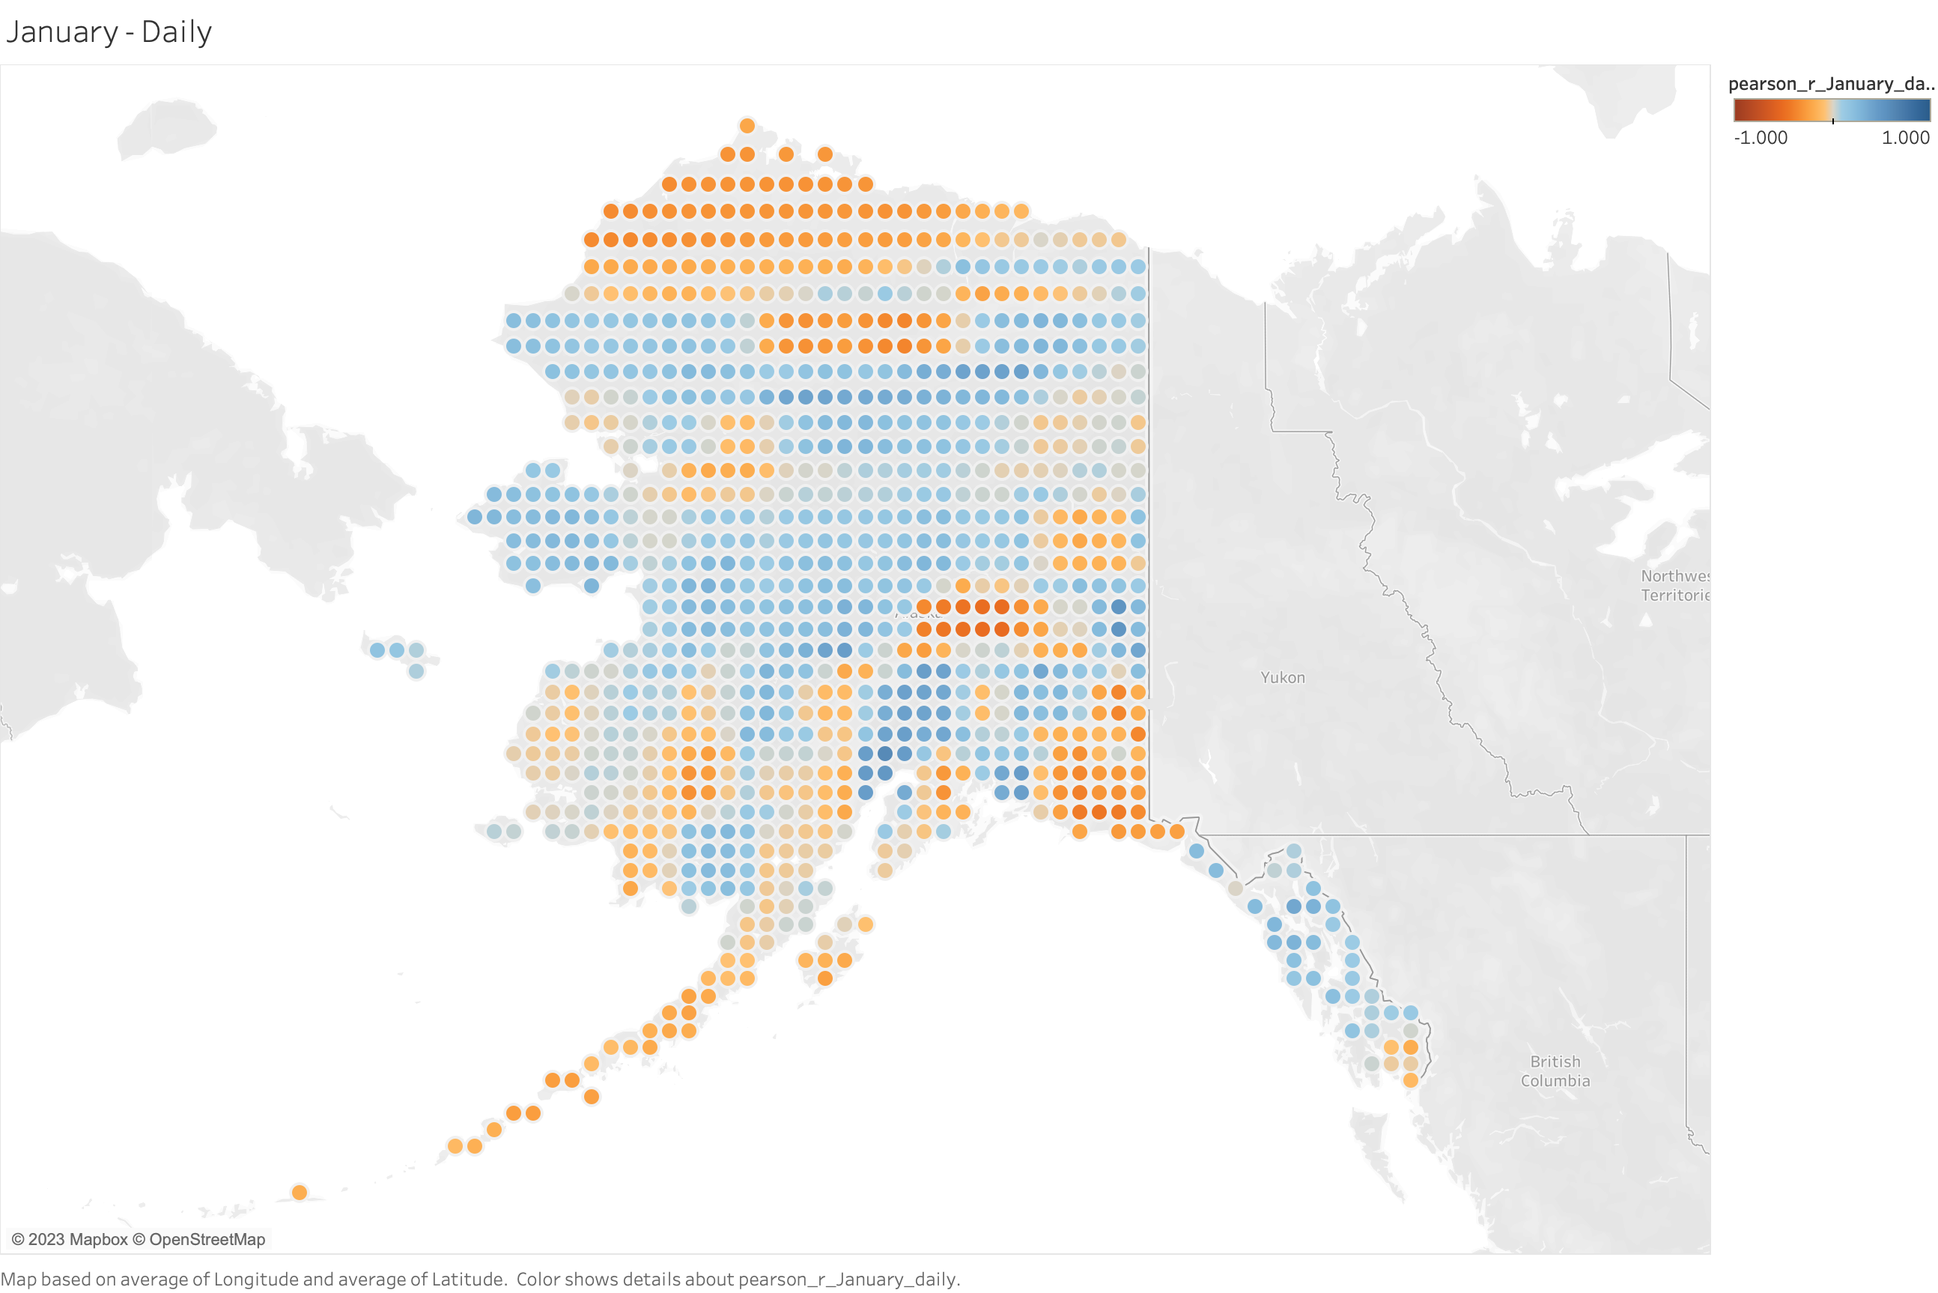
﻿0.284717

Slide 3
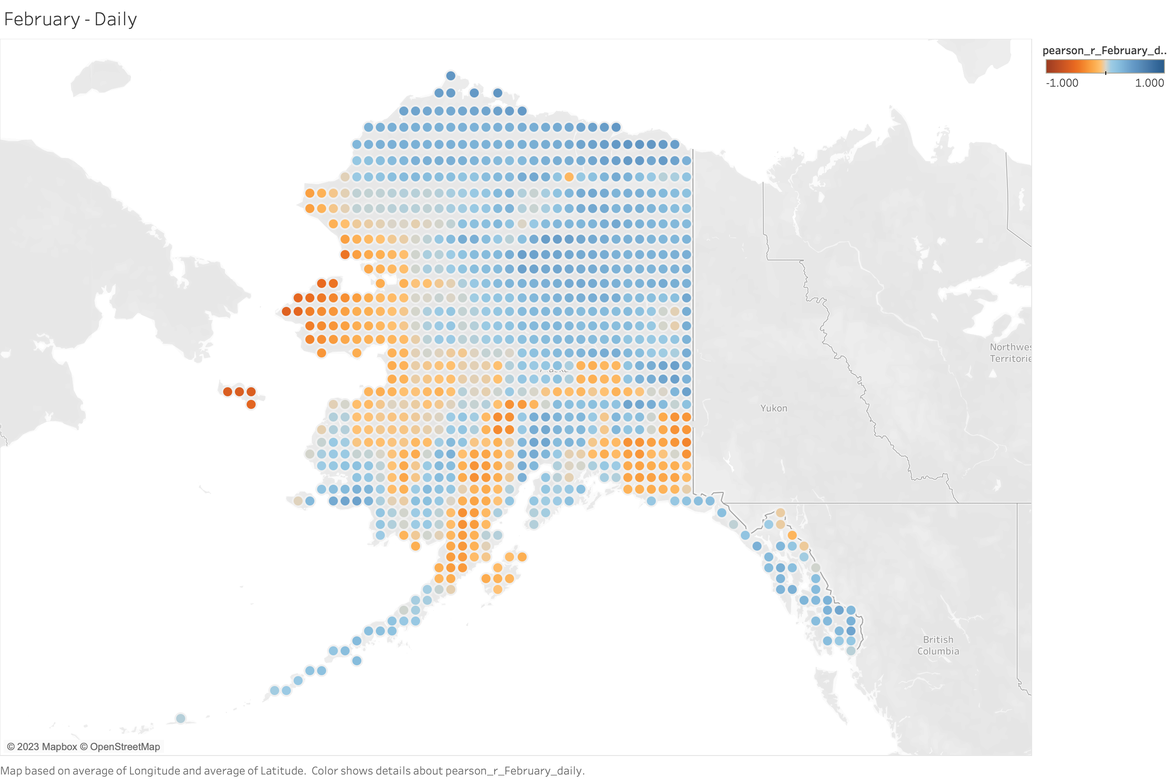
﻿﻿0.0314635

Slide 4
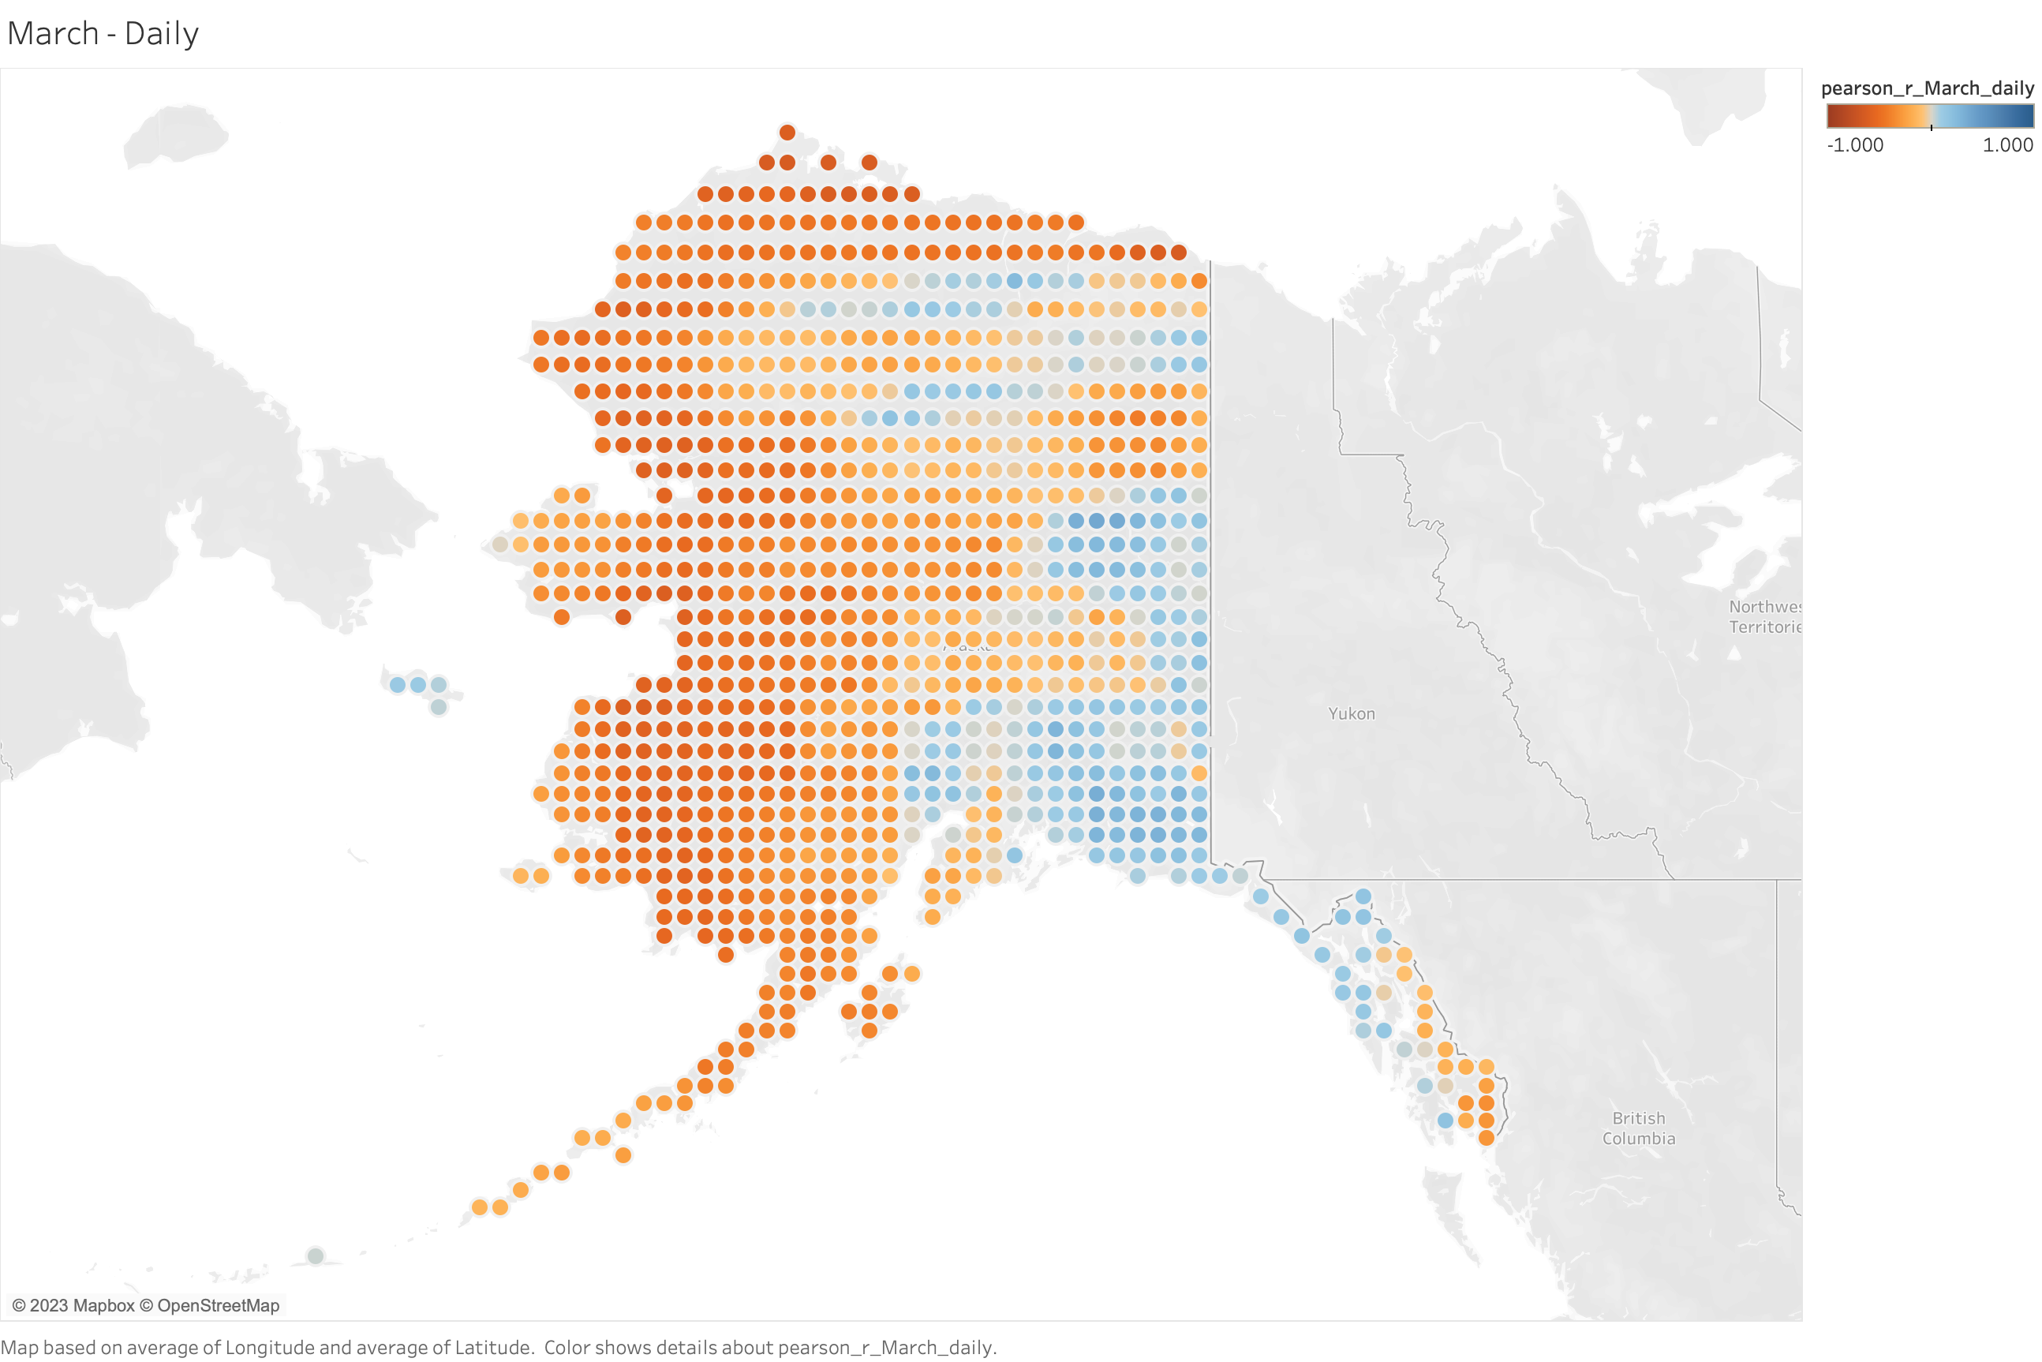
﻿﻿-0.327760

Slide 5
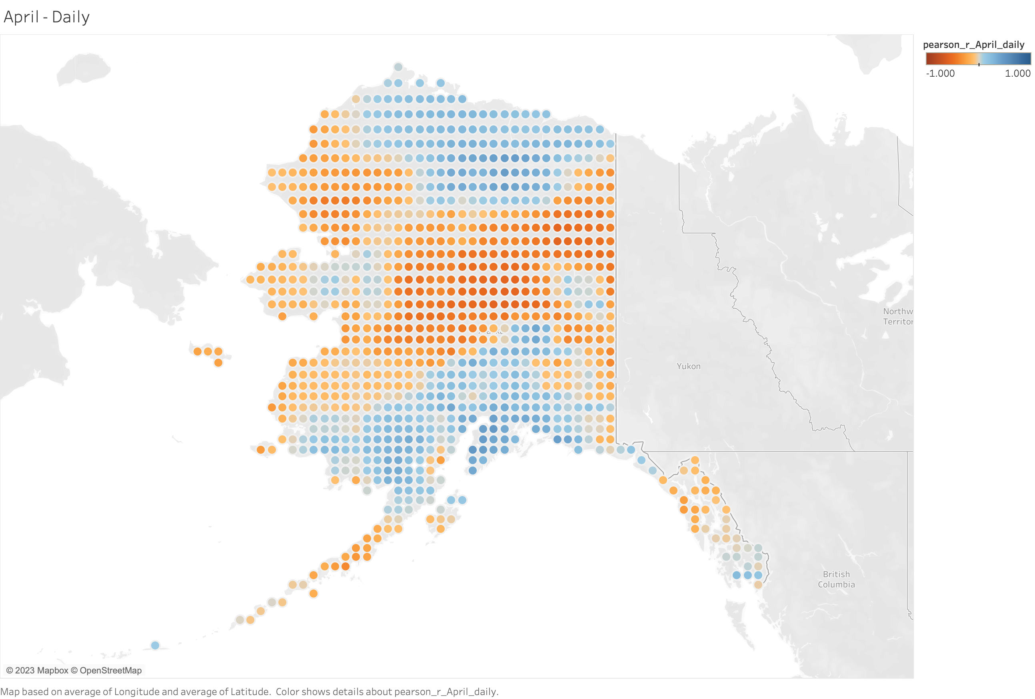
﻿﻿-0.212493

Slide 6
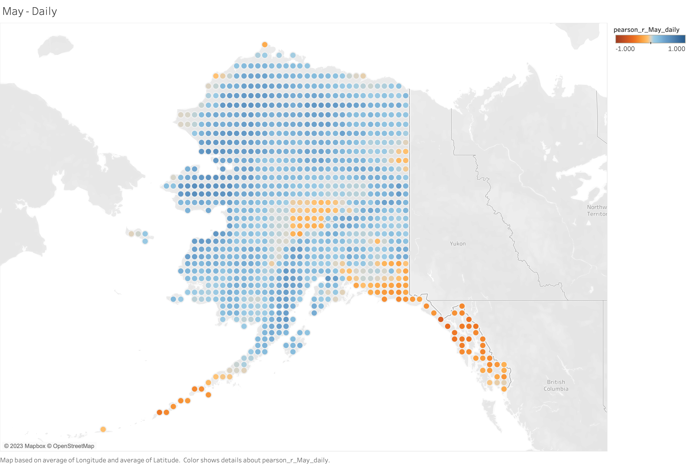
﻿﻿0.0423061

Slide 7
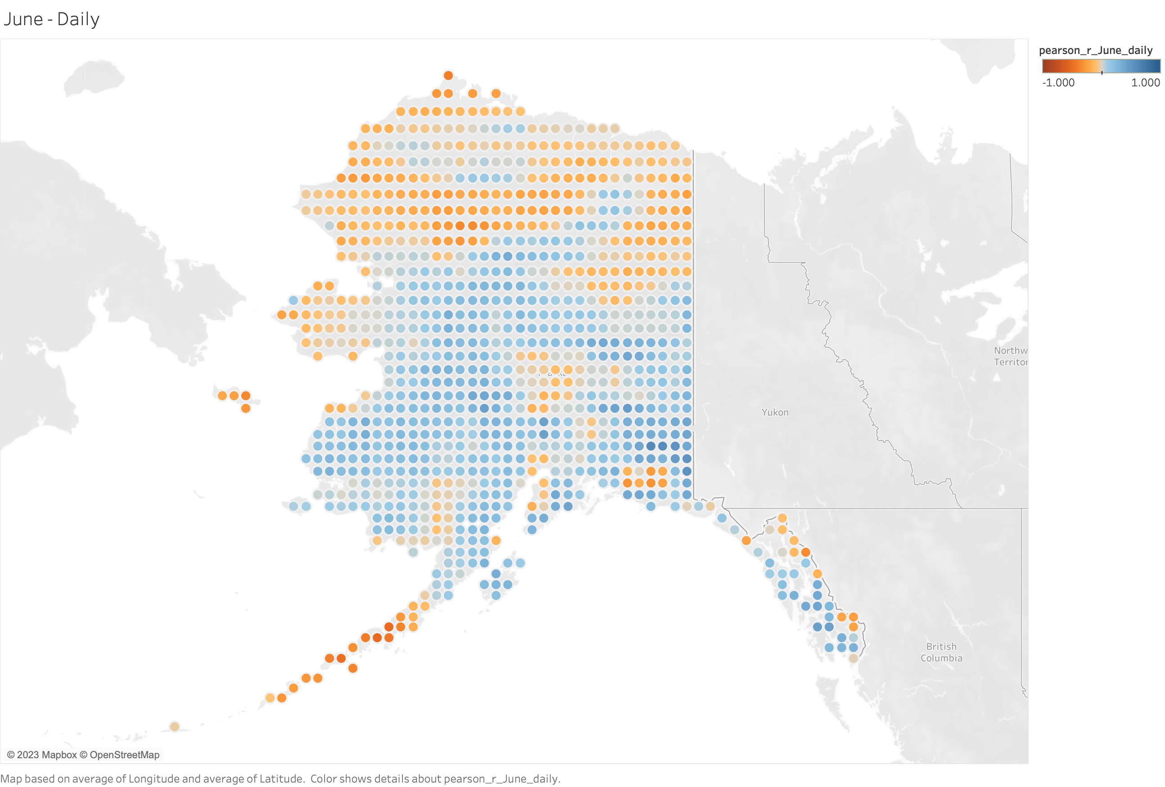
﻿﻿0.171254

Slide 8
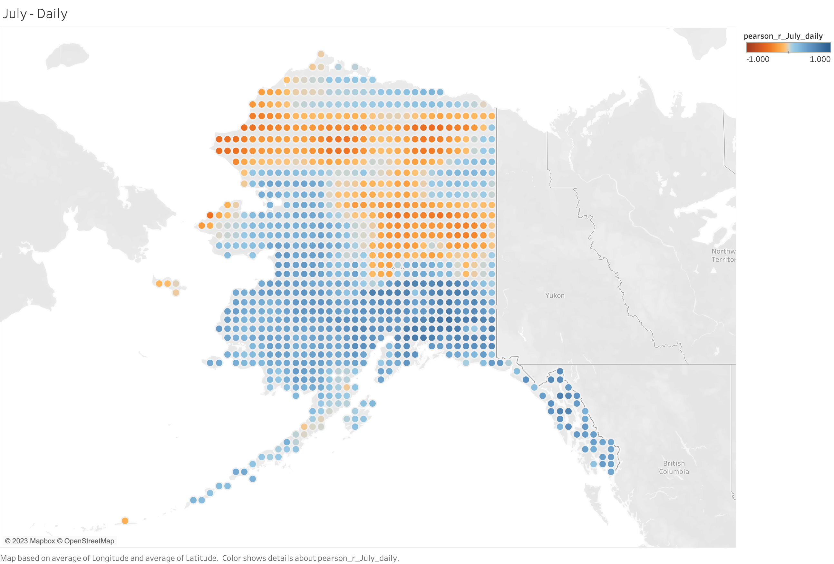
﻿﻿0.473581

Slide 9
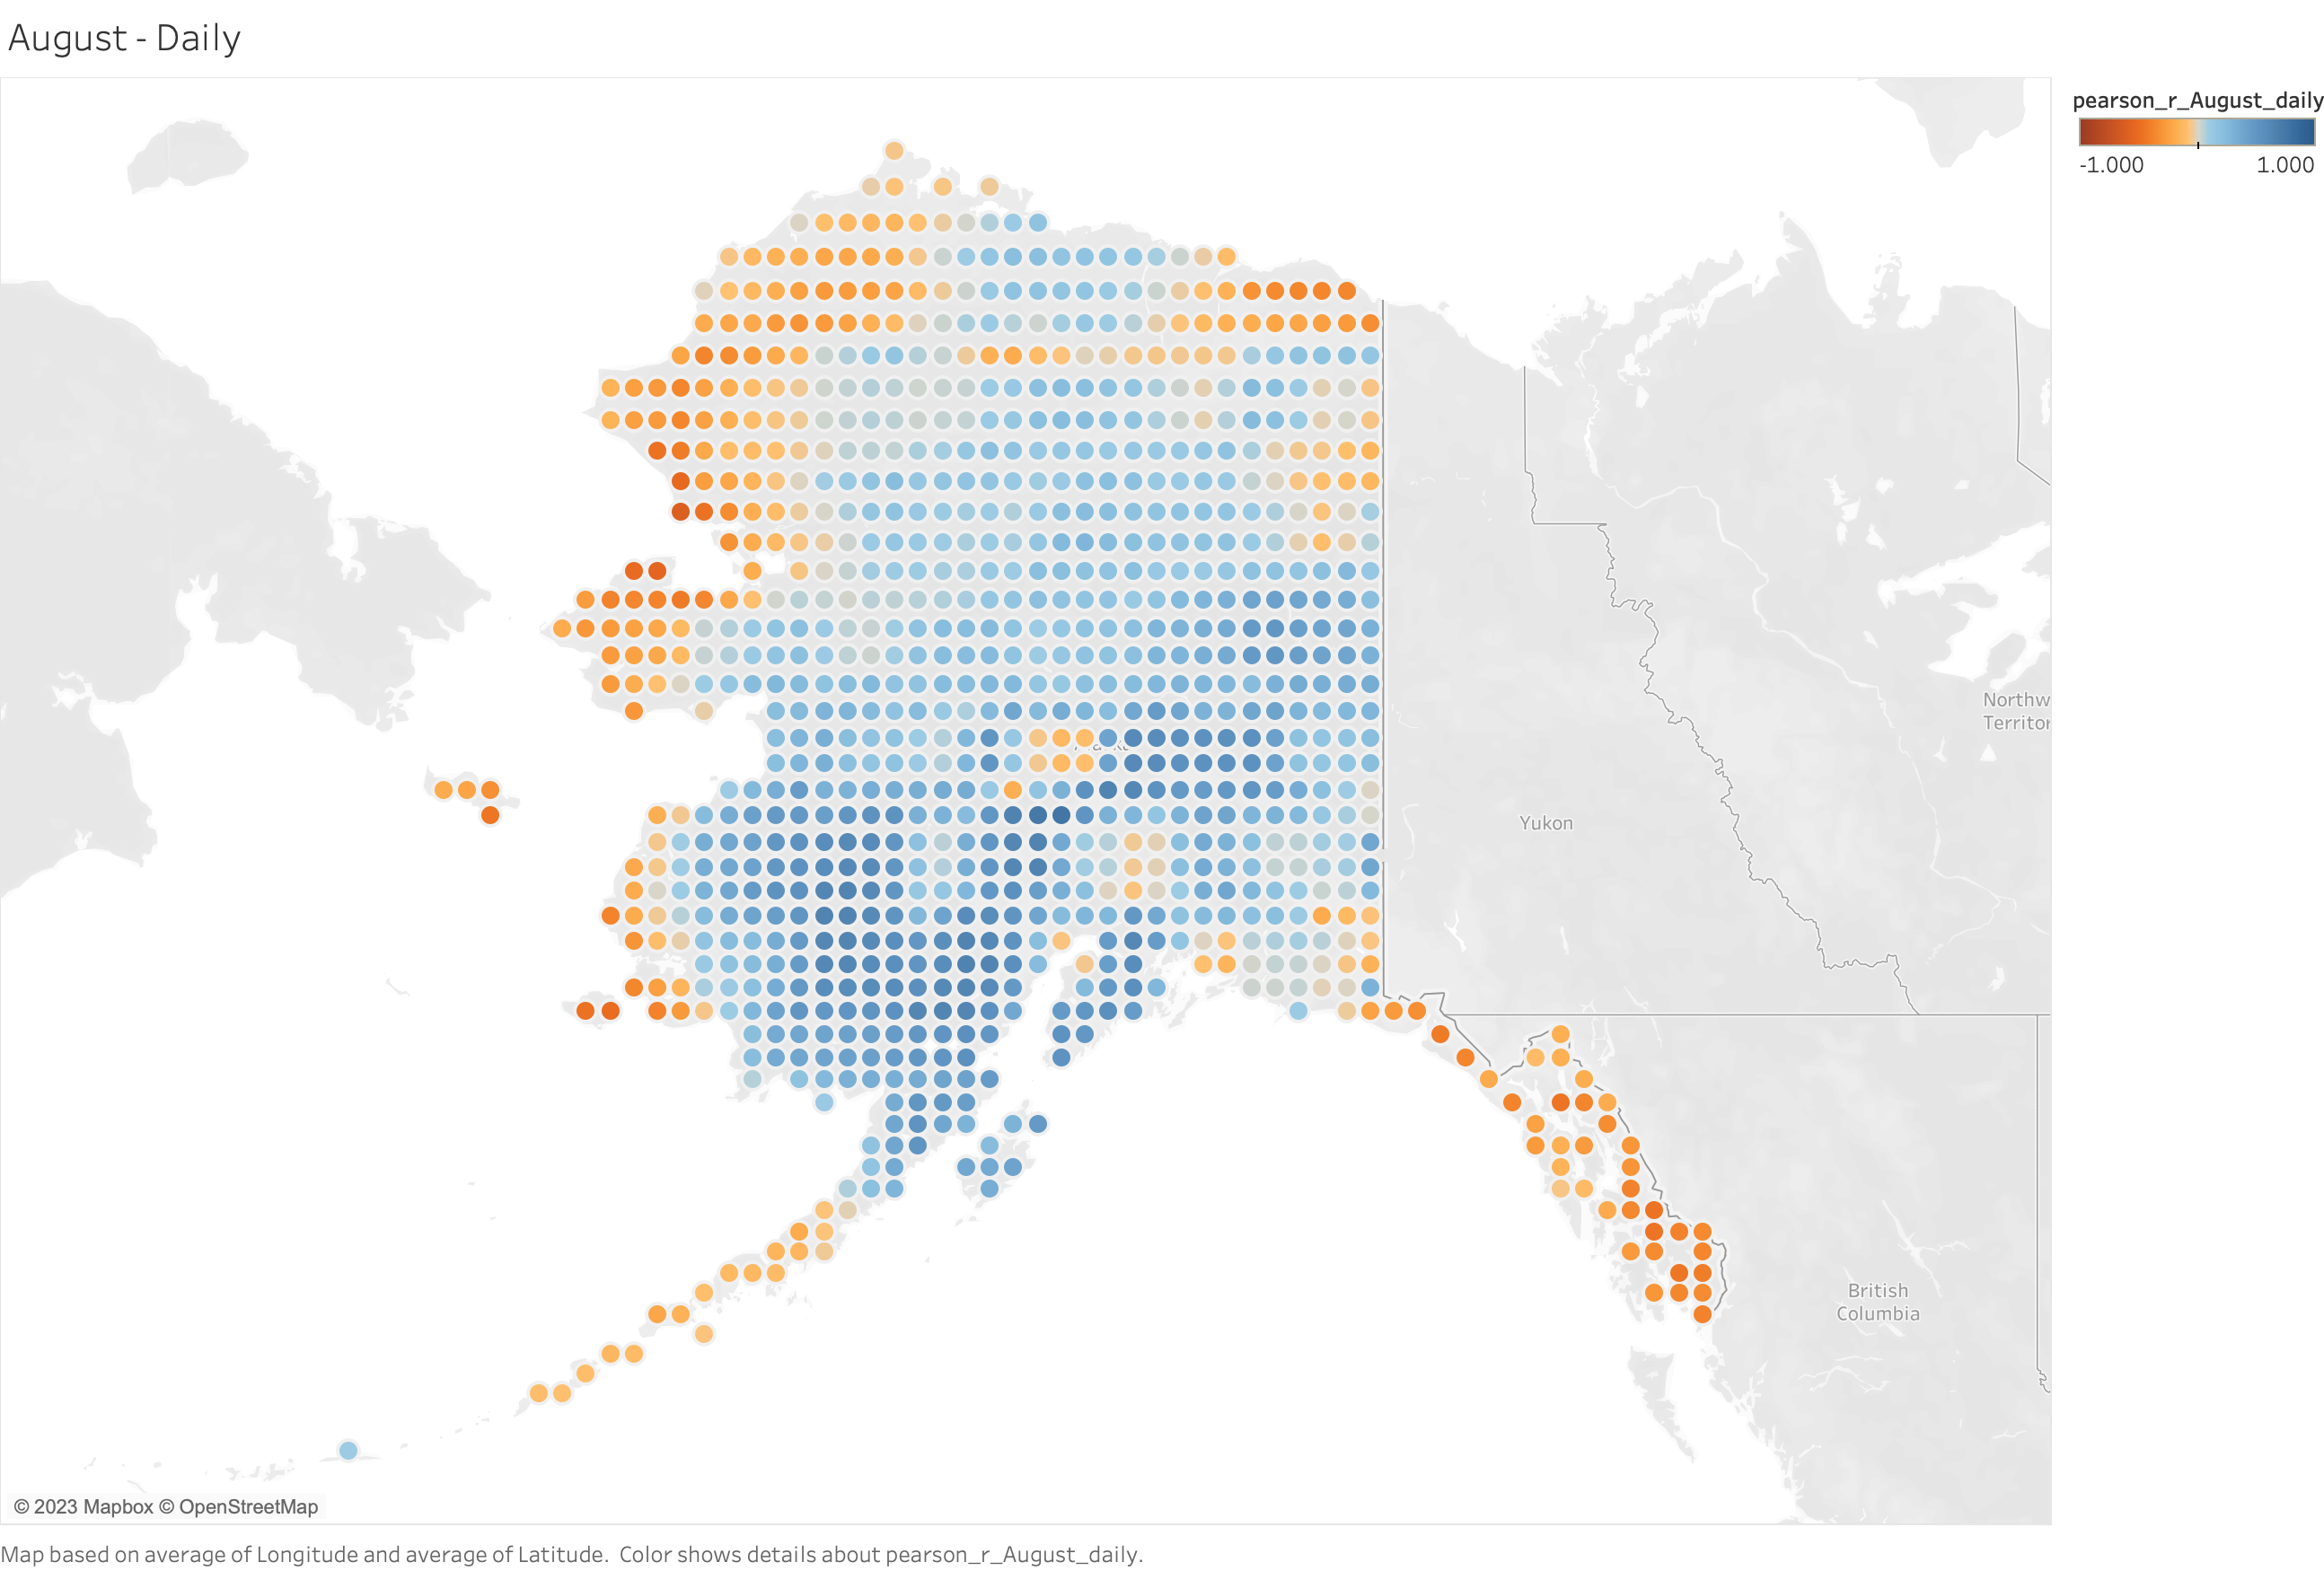
﻿﻿0.312117

Slide 10
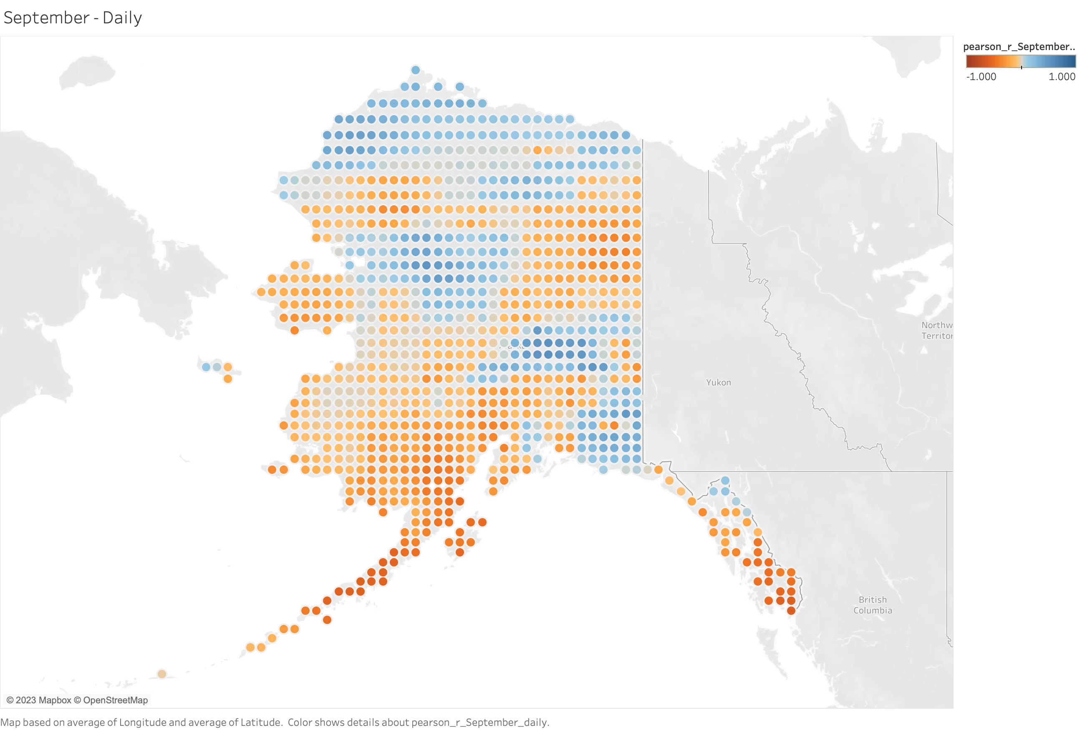
﻿﻿-0.327873

Slide 11
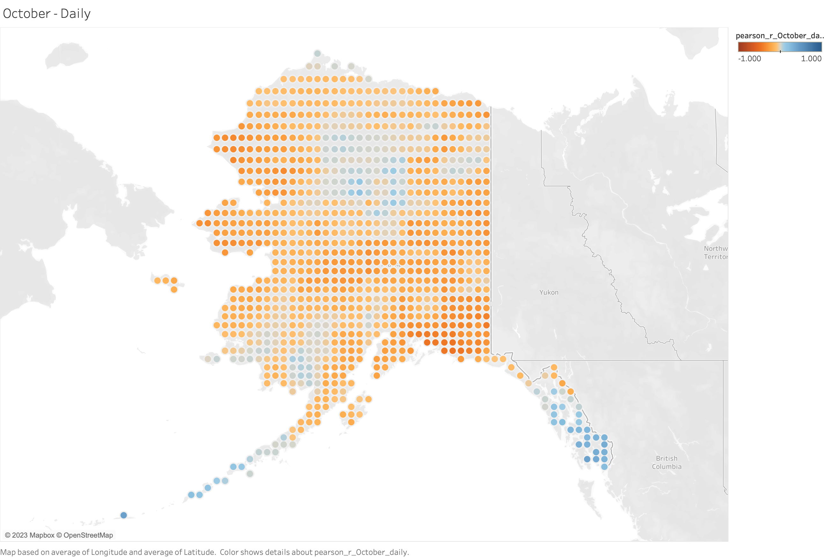
﻿﻿-0.165609

Slide 12
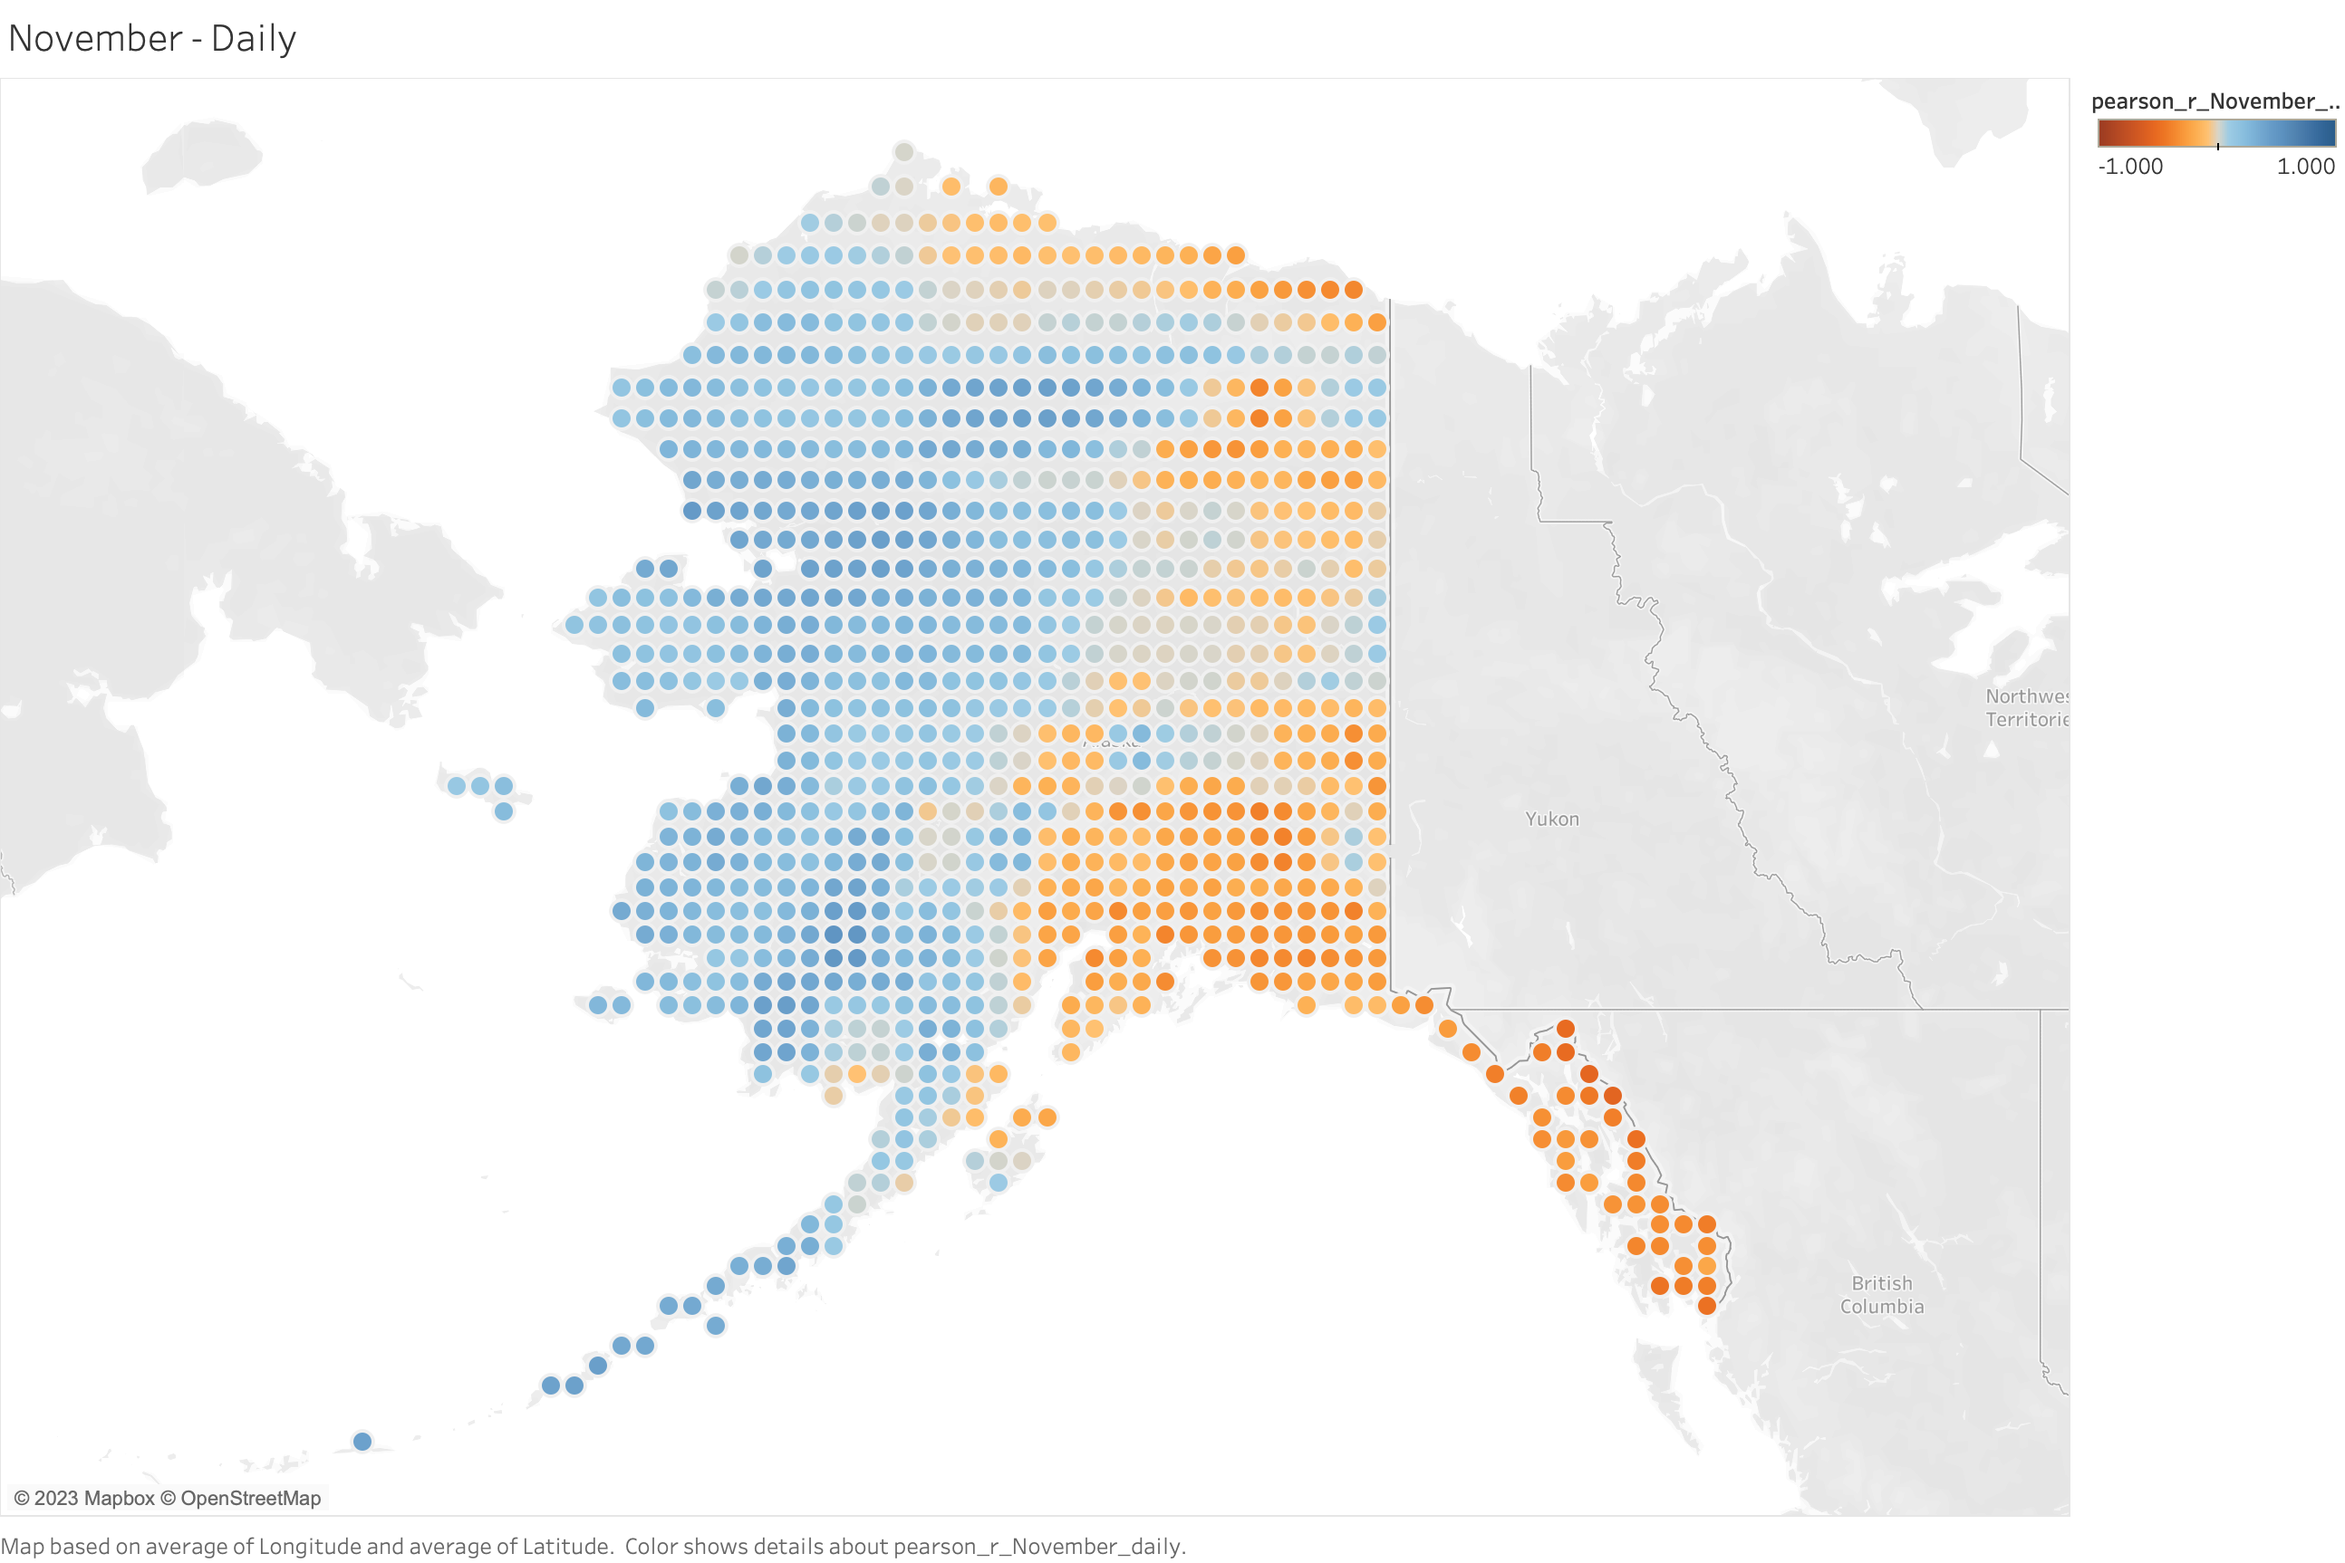
﻿﻿-0.0579051

Slide 13
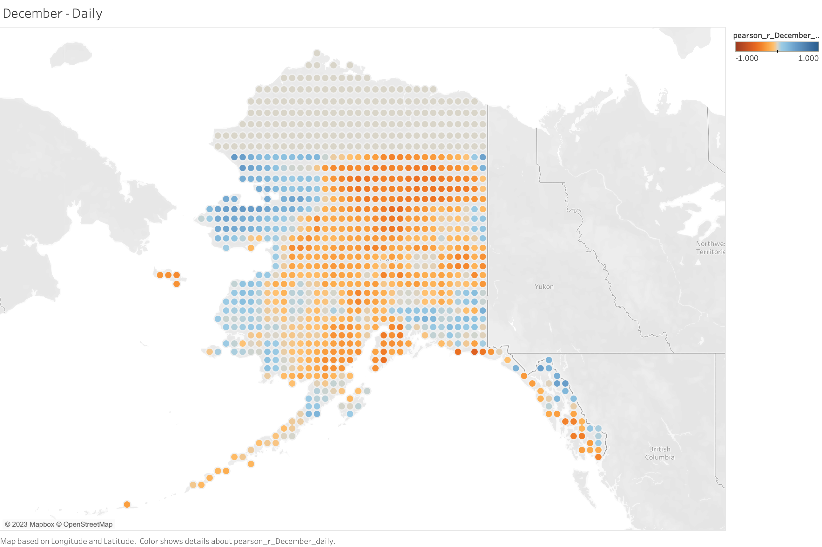
﻿-0.251924

Slide 14
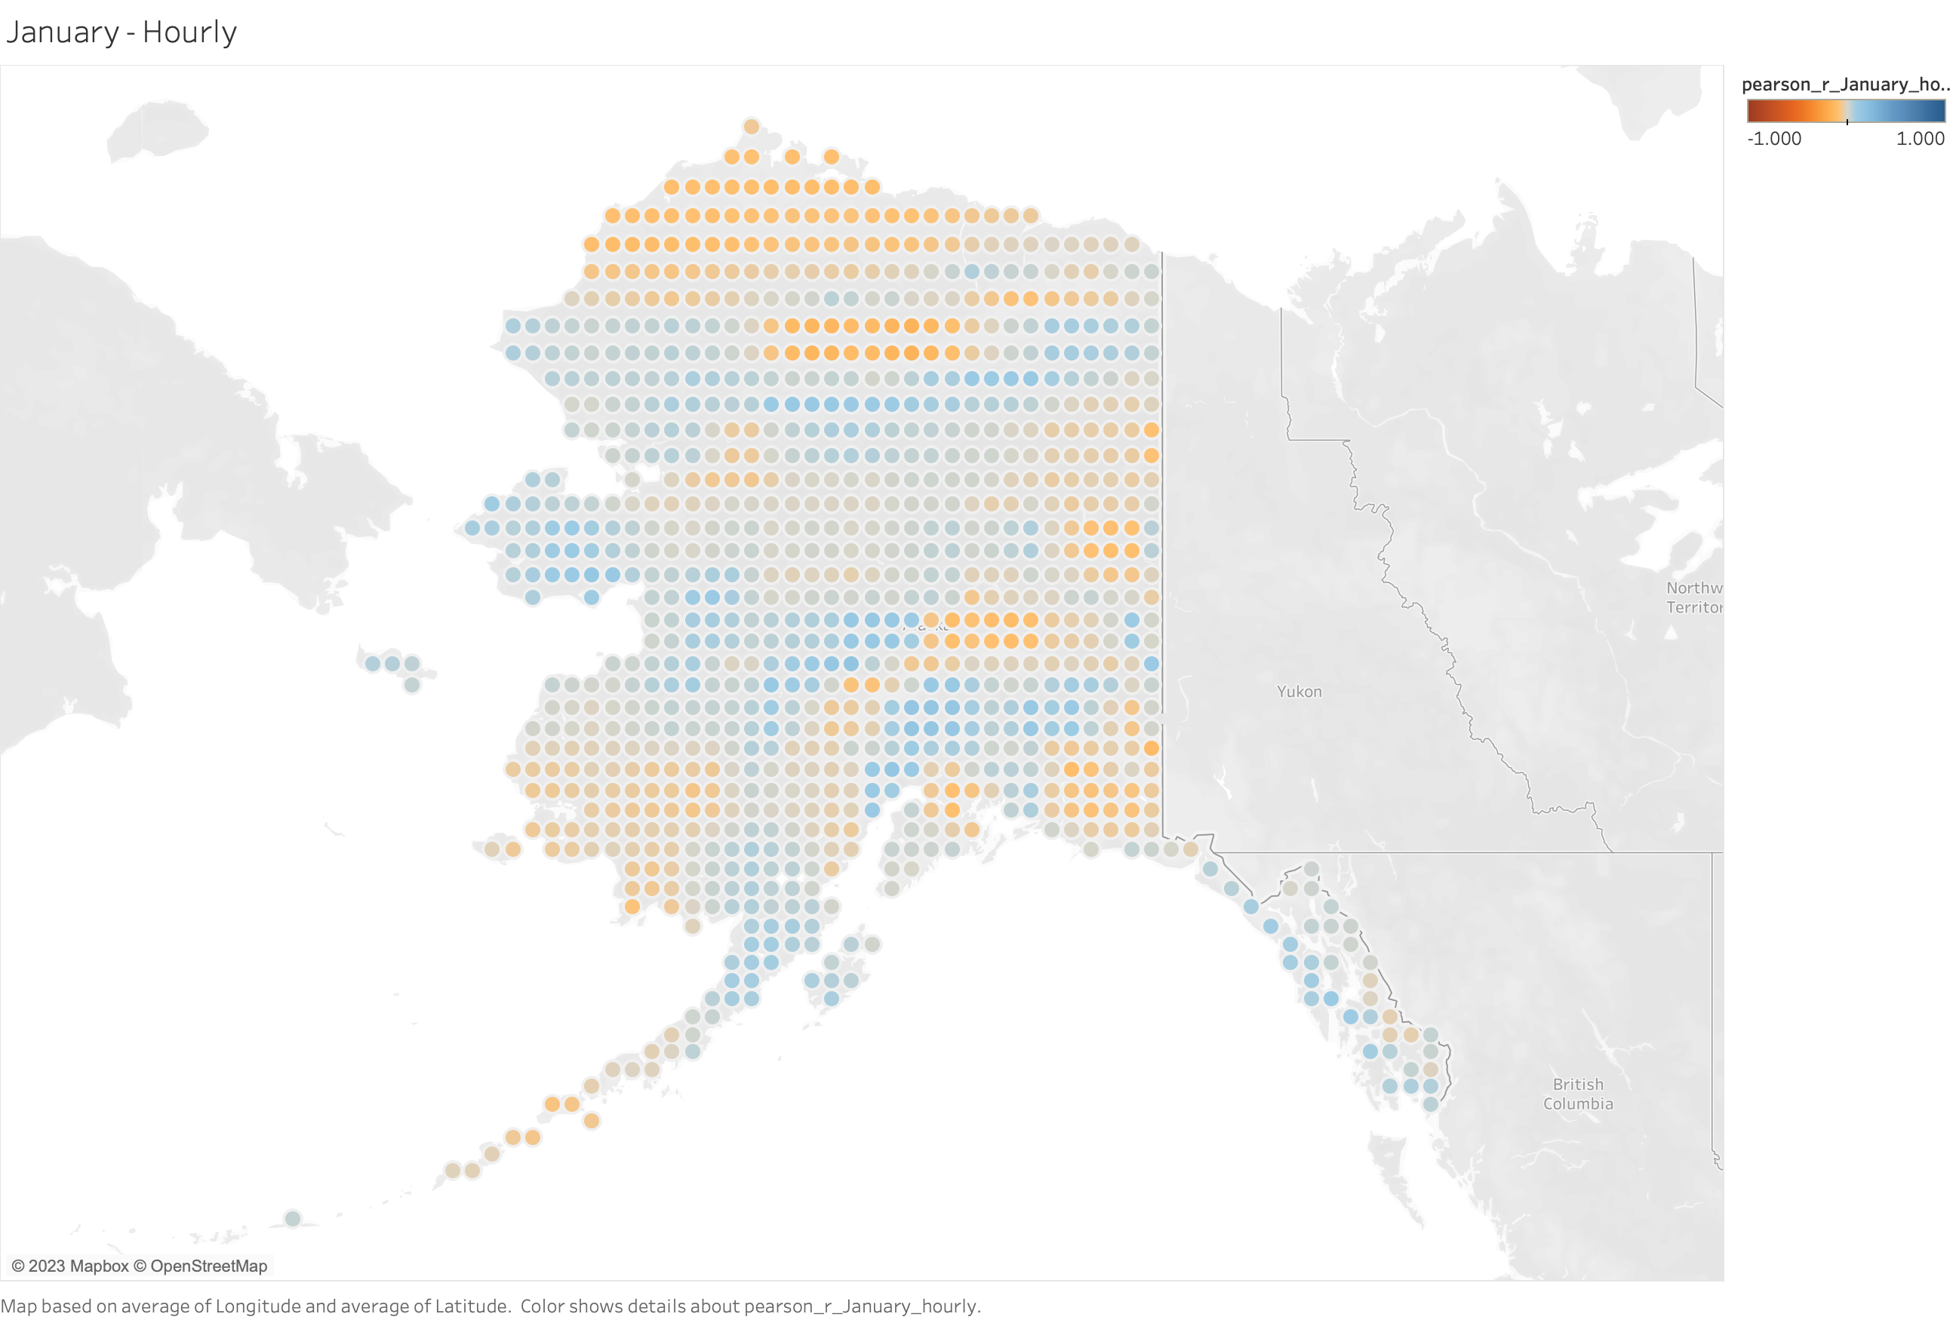
﻿0.117972

Slide 15
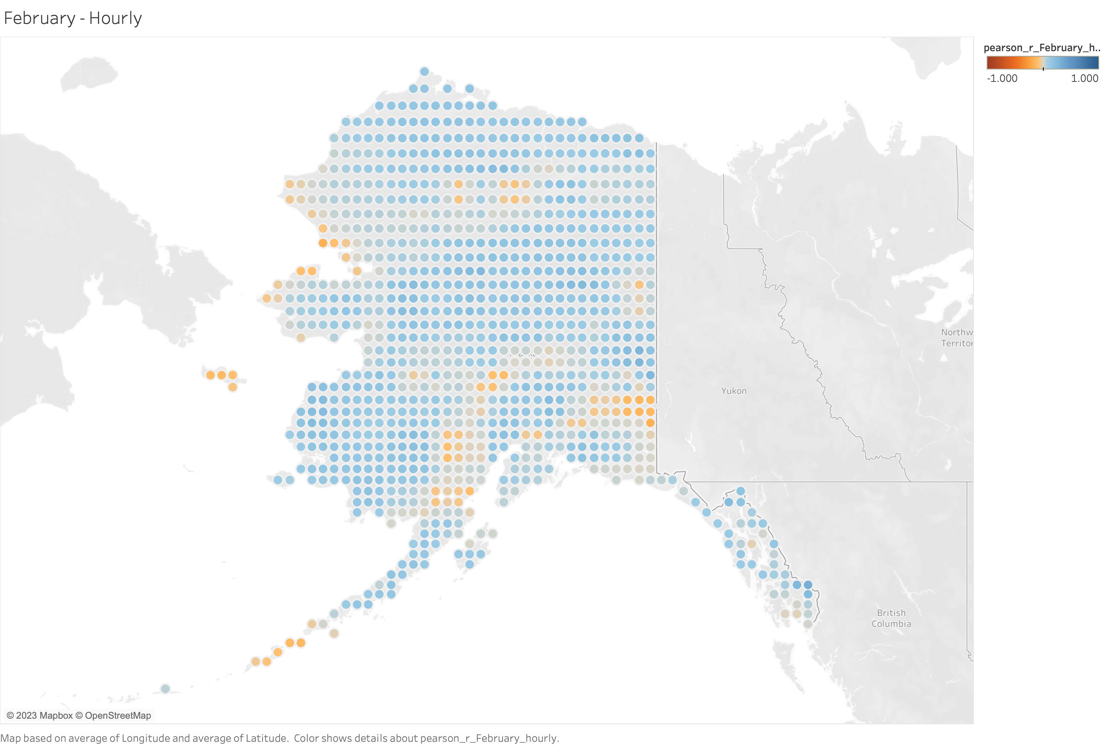
﻿0.00592870

Slide 16
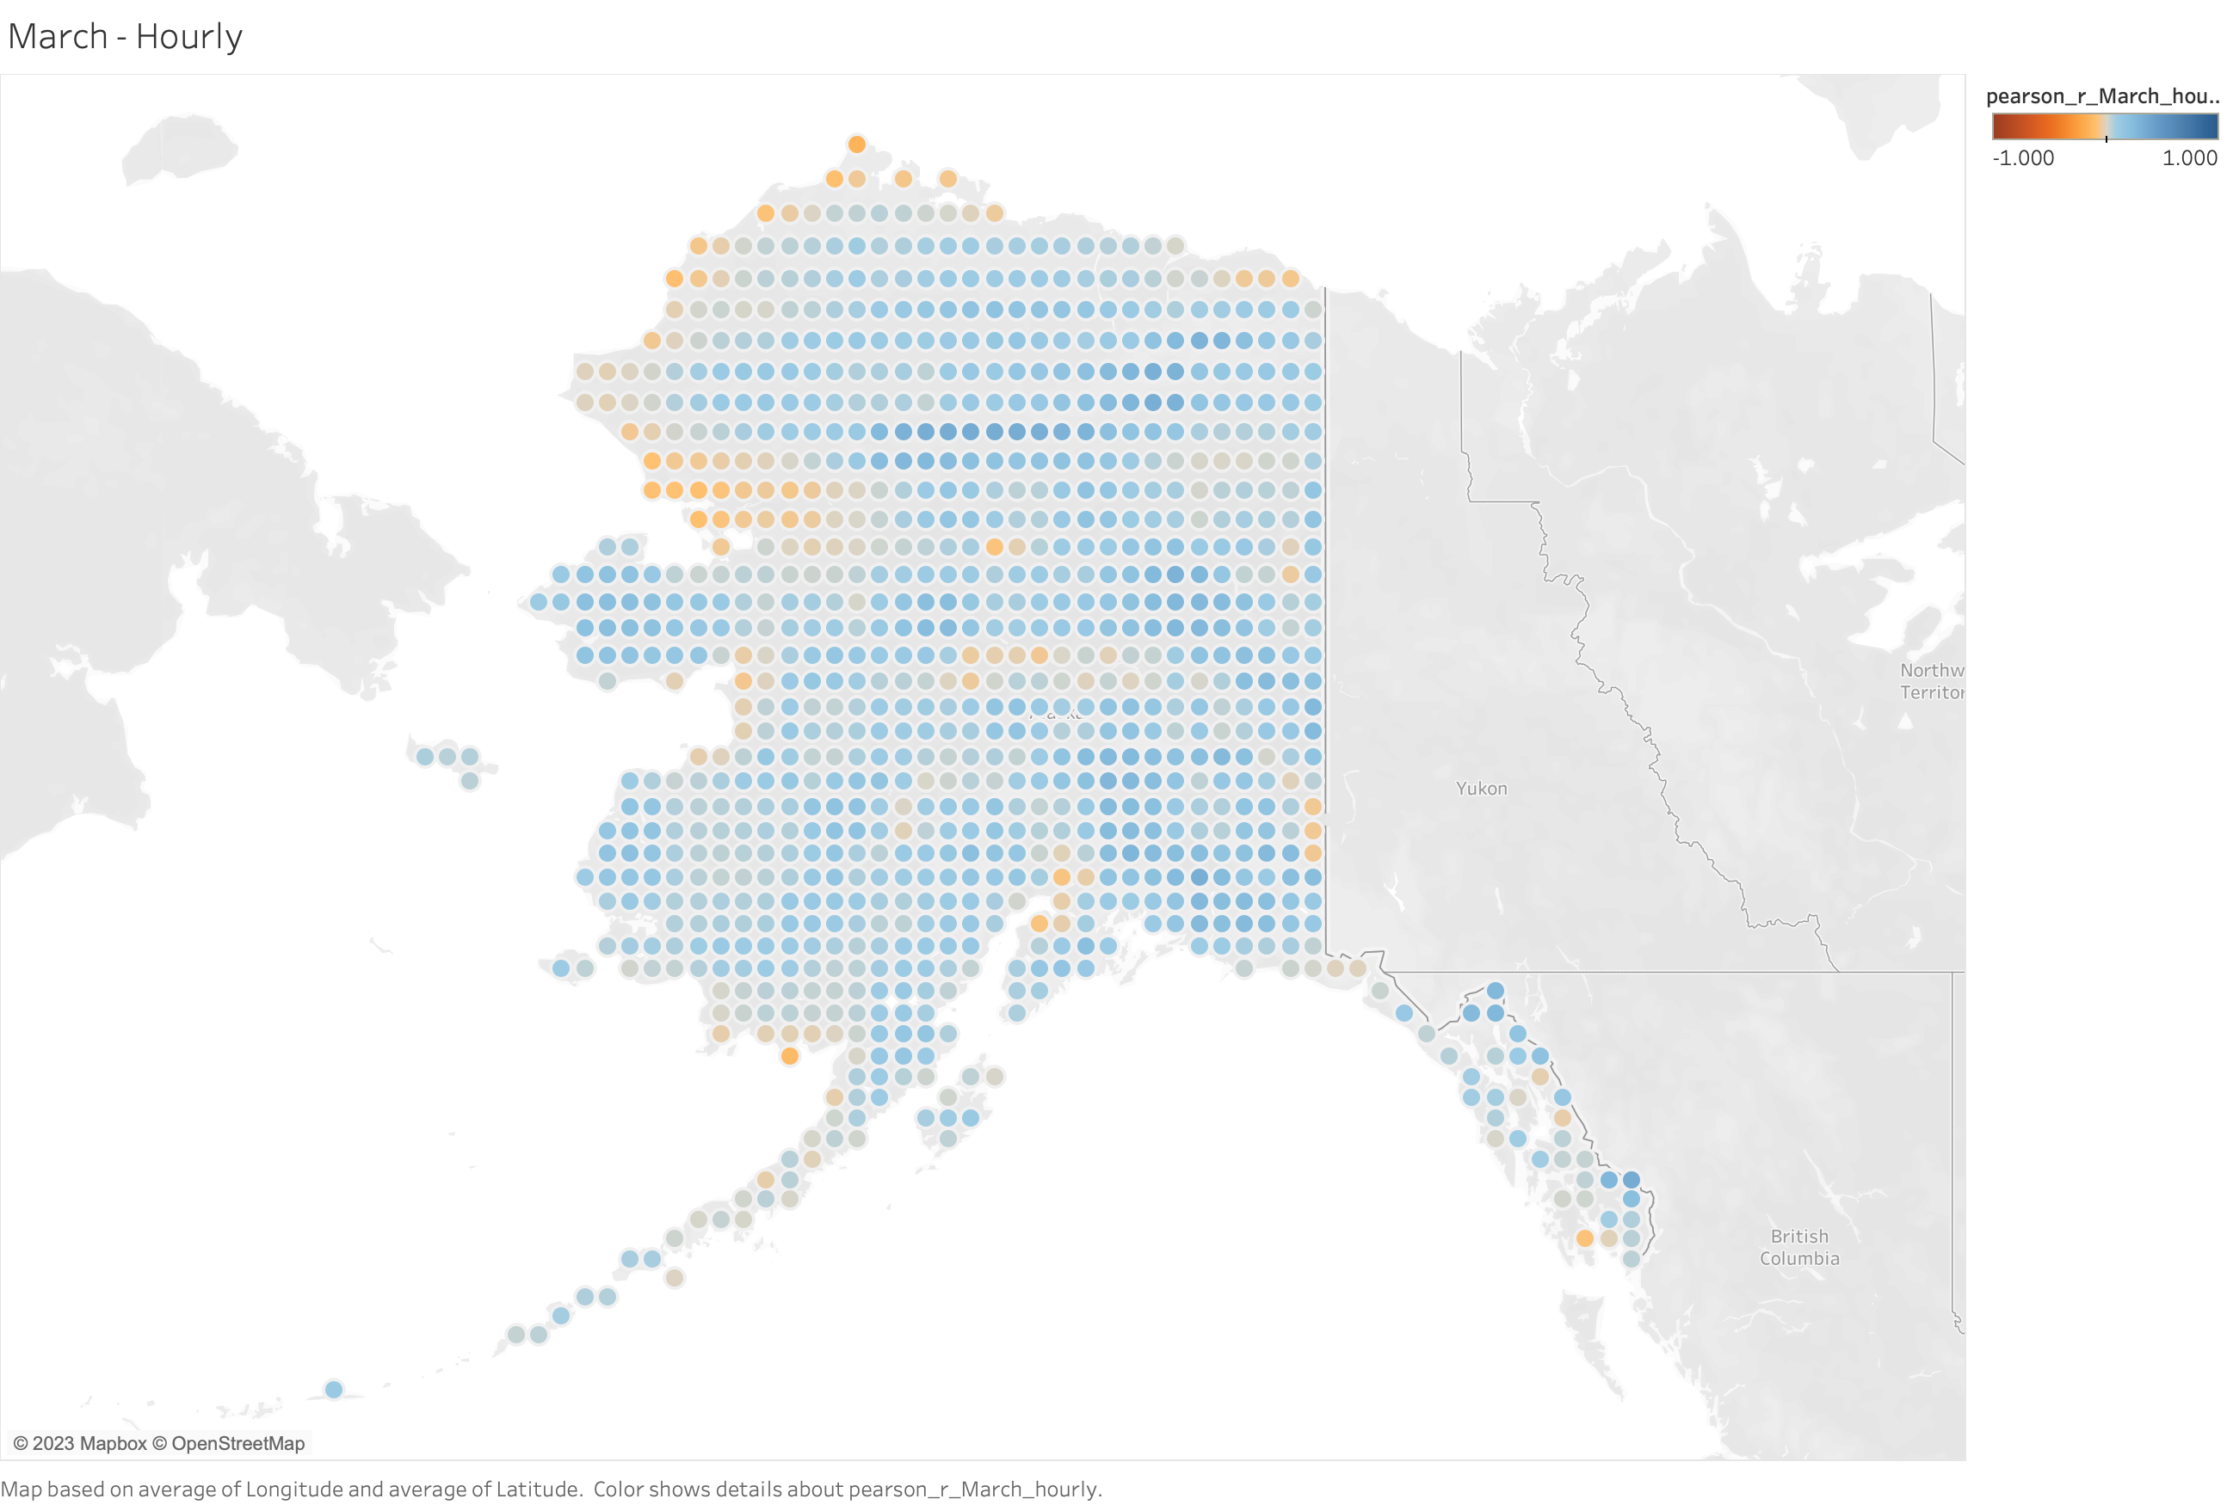
﻿0.154633

Slide 17
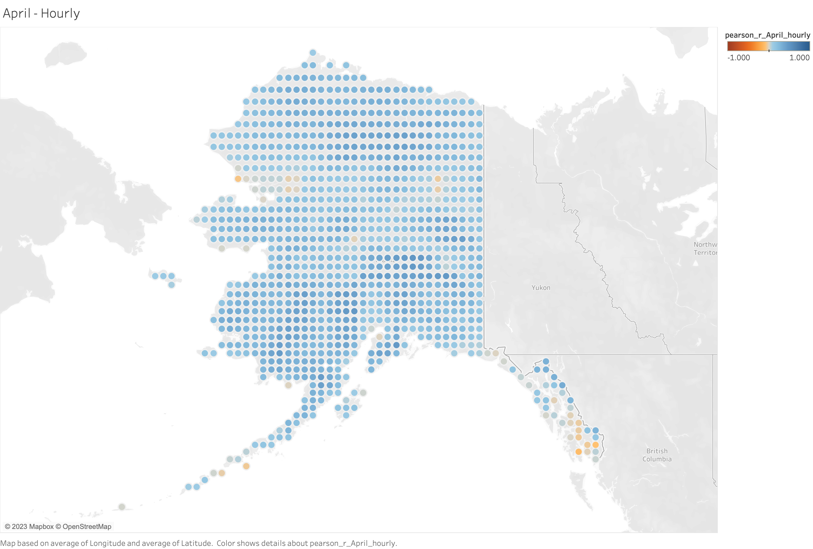
﻿0.290336

Slide 18
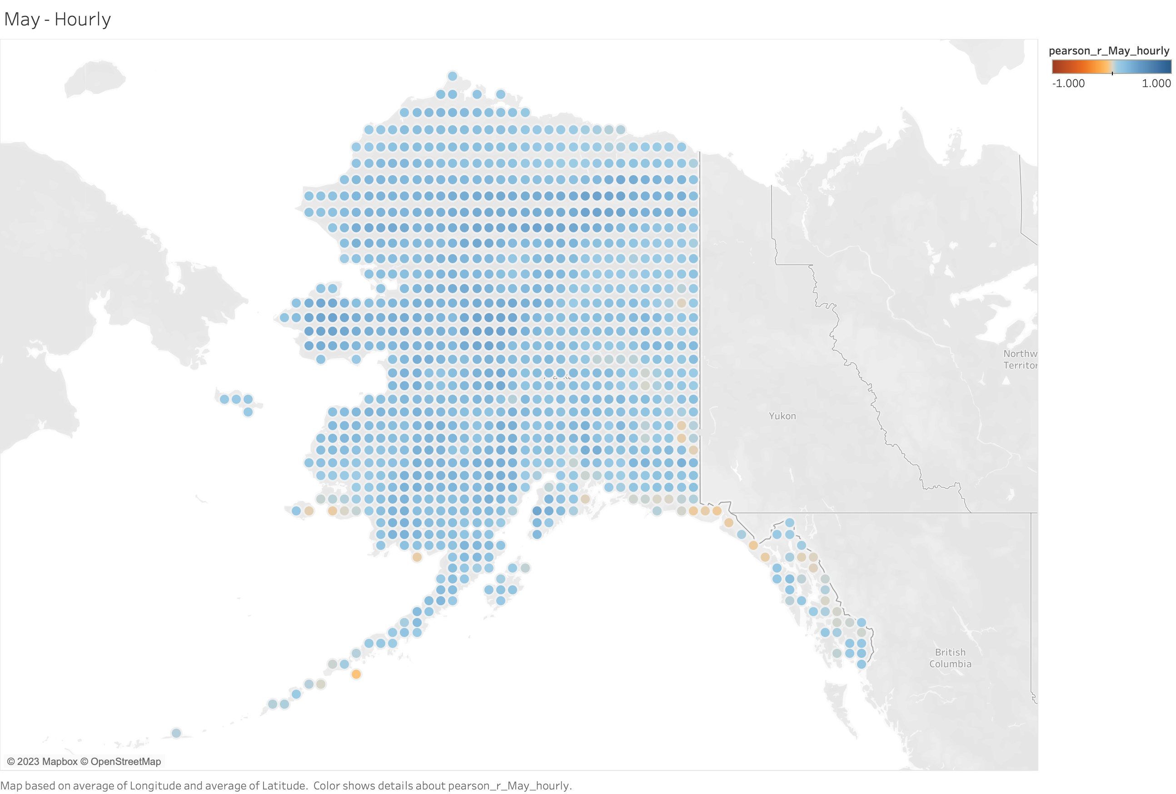
﻿﻿0.207242

Slide 19
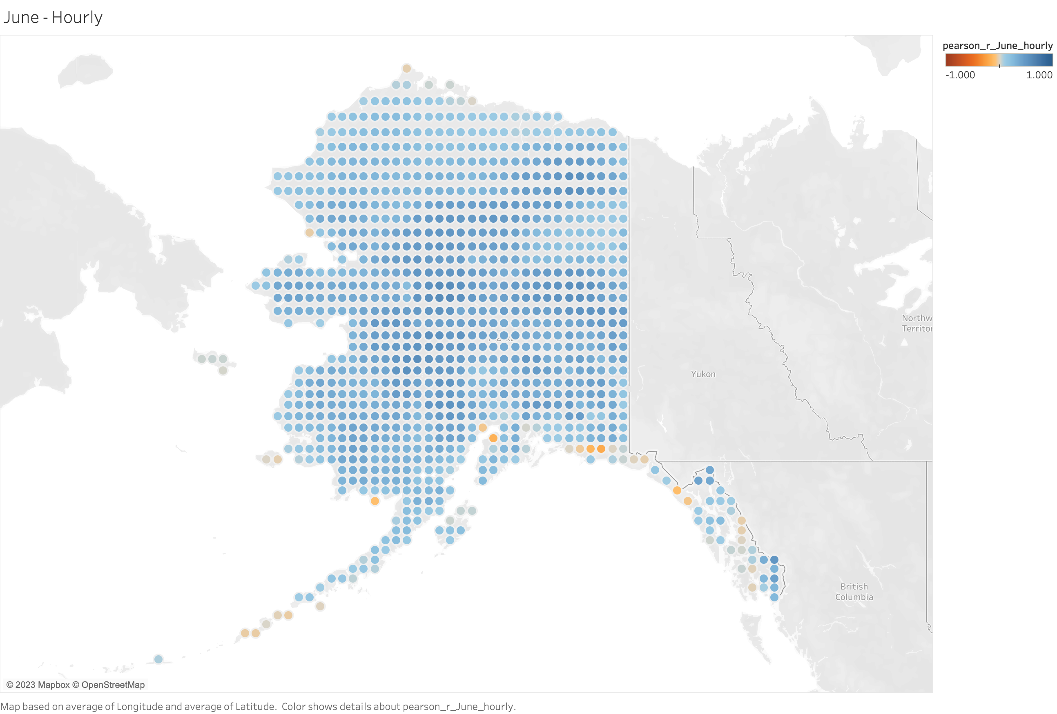
﻿﻿0.463662

Slide 20
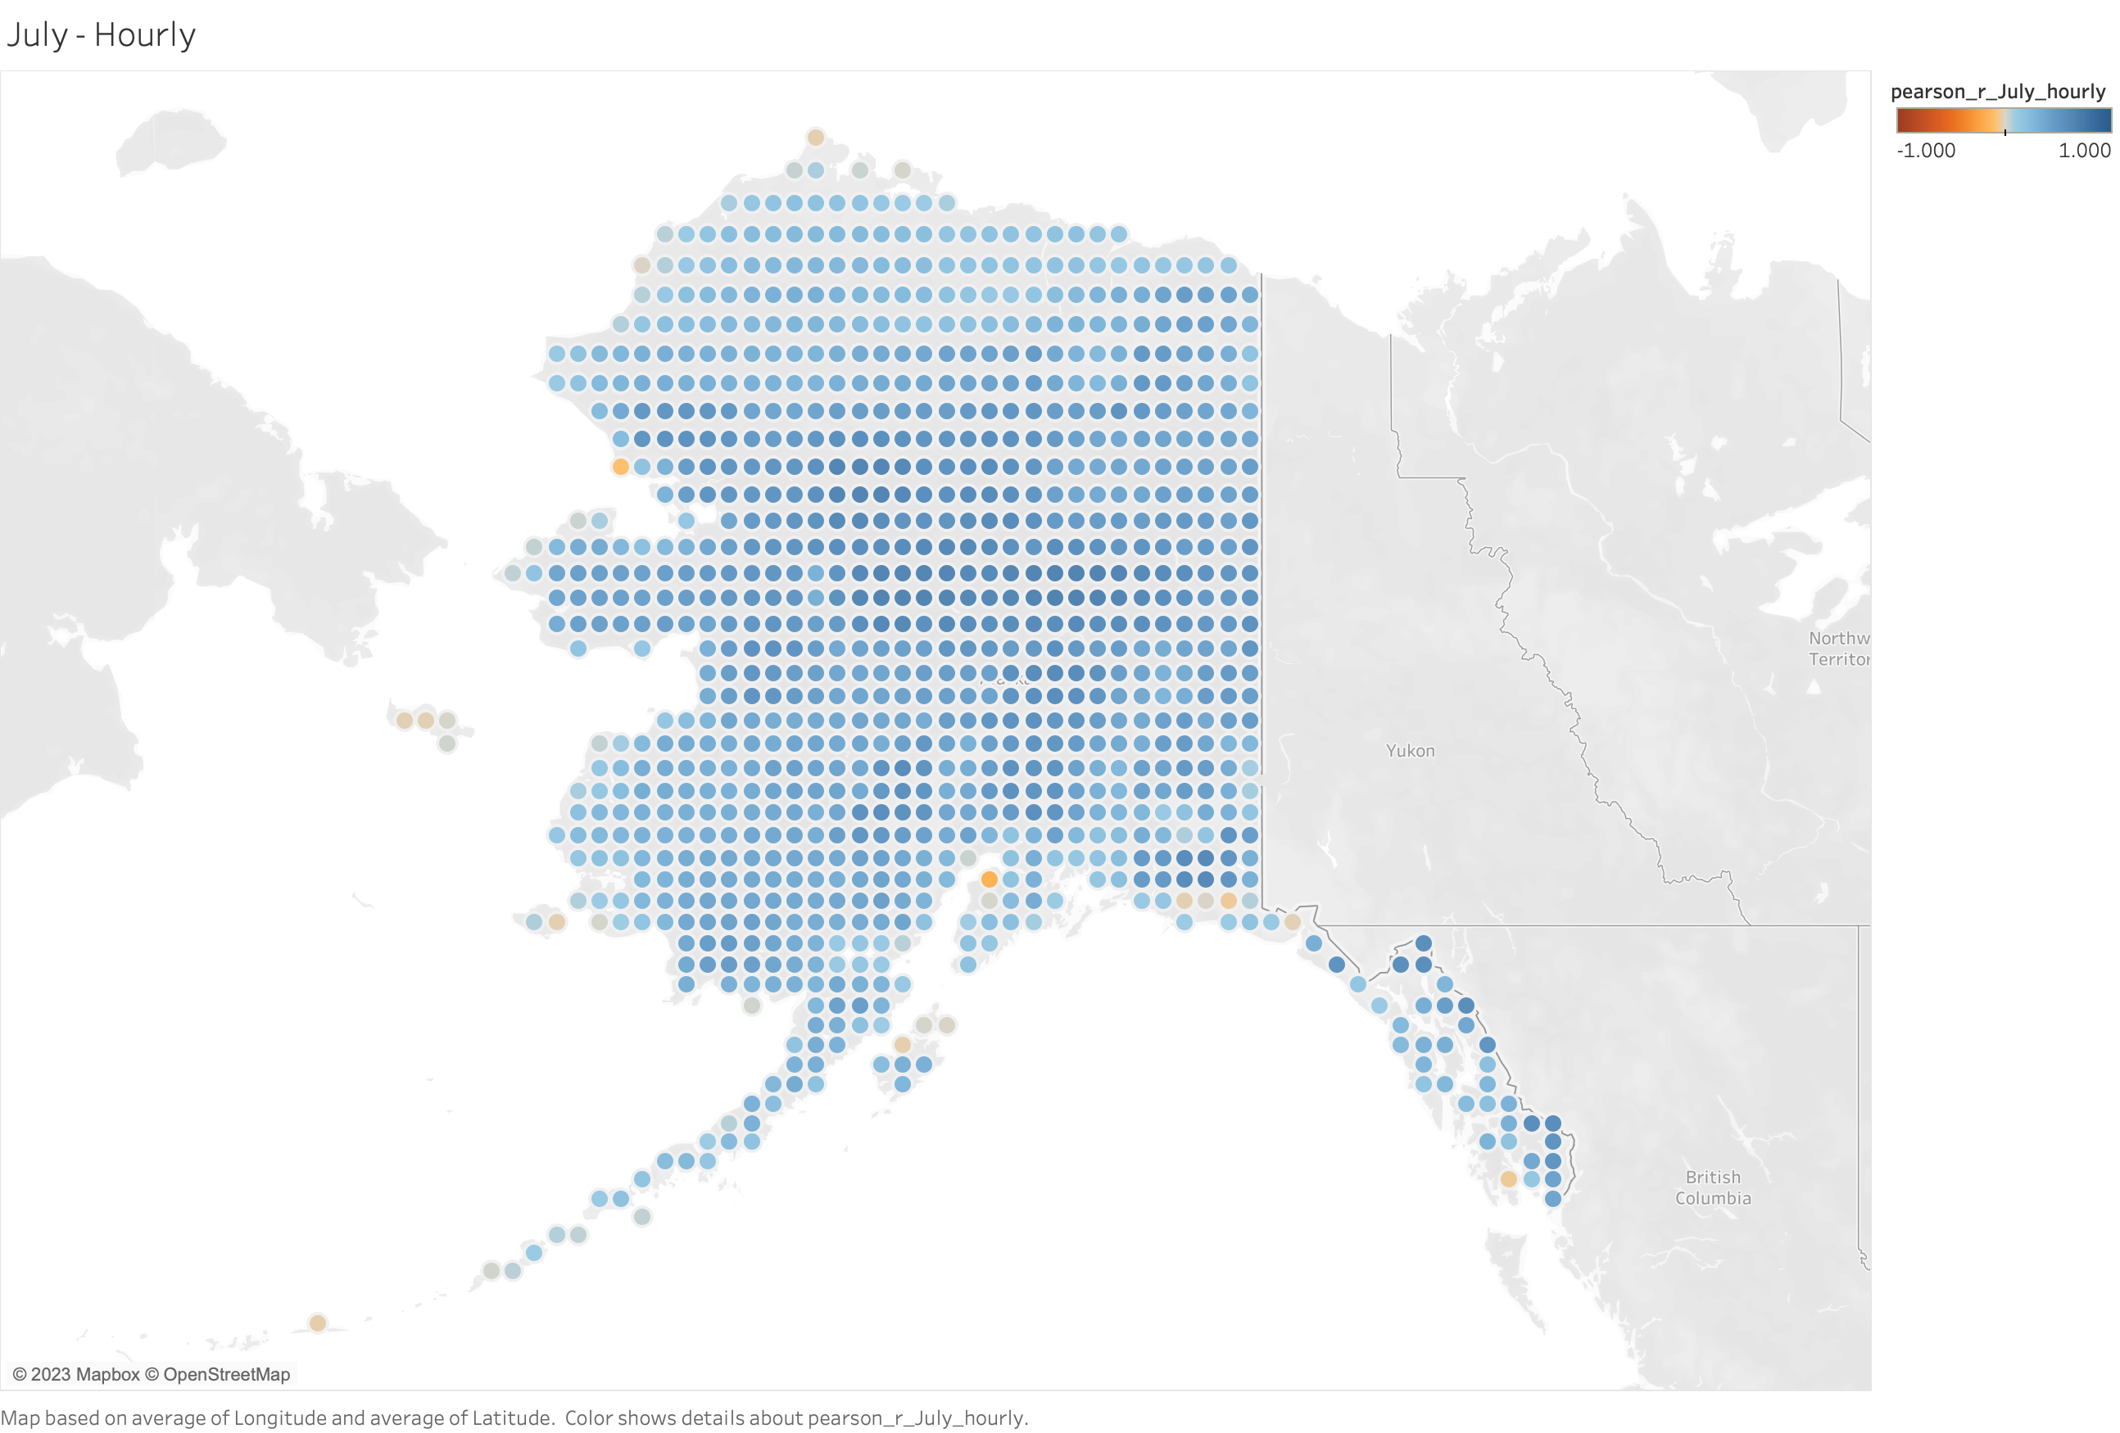
﻿﻿0.358464

Slide 21

﻿0.400384

Slide 22
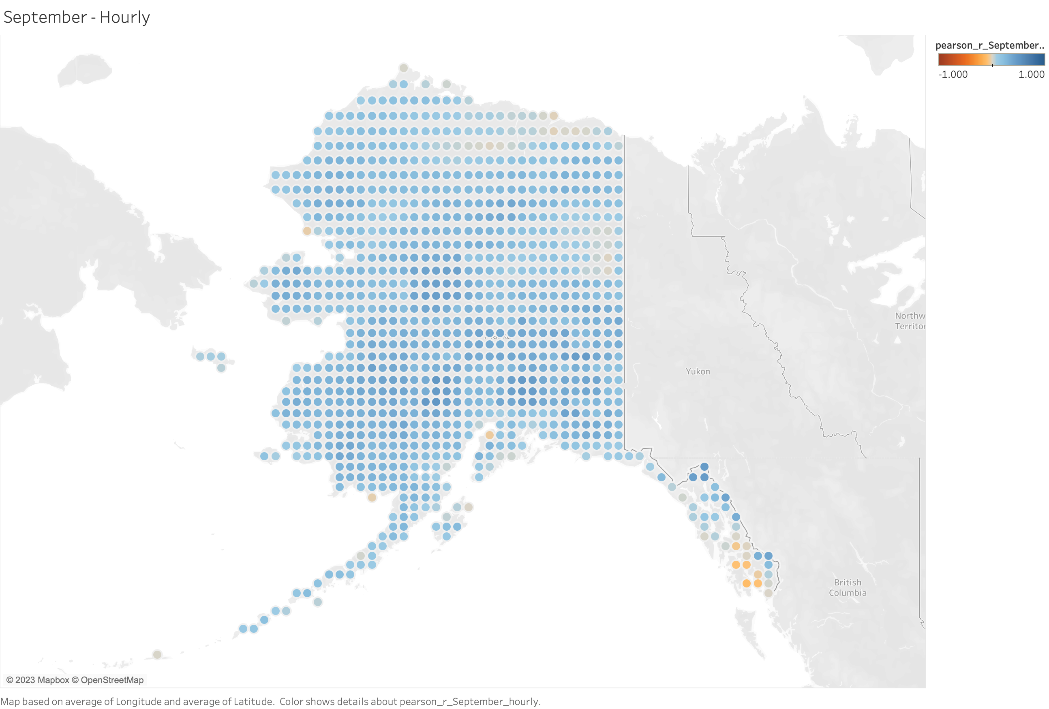
﻿﻿0.243700

Slide 23
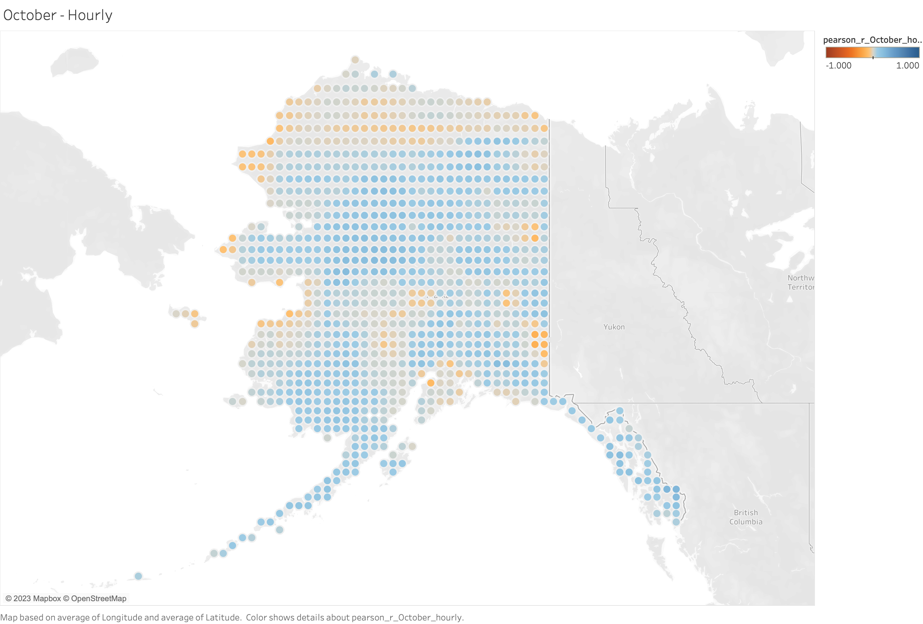
﻿0.0388513

Slide 24
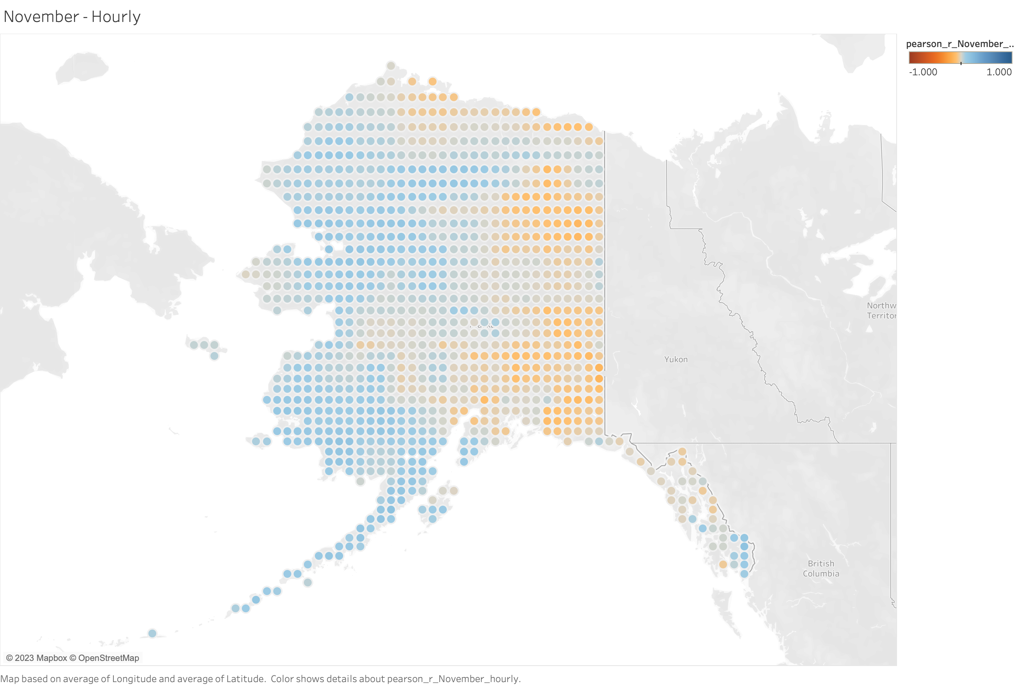
﻿-0.0158006

Slide 25
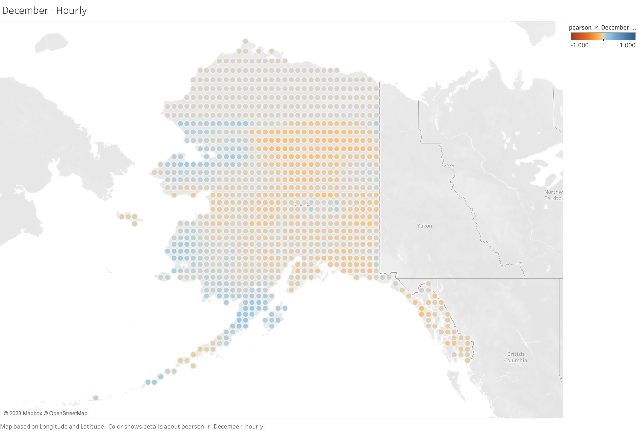
﻿﻿-0.0589036

Slide 26
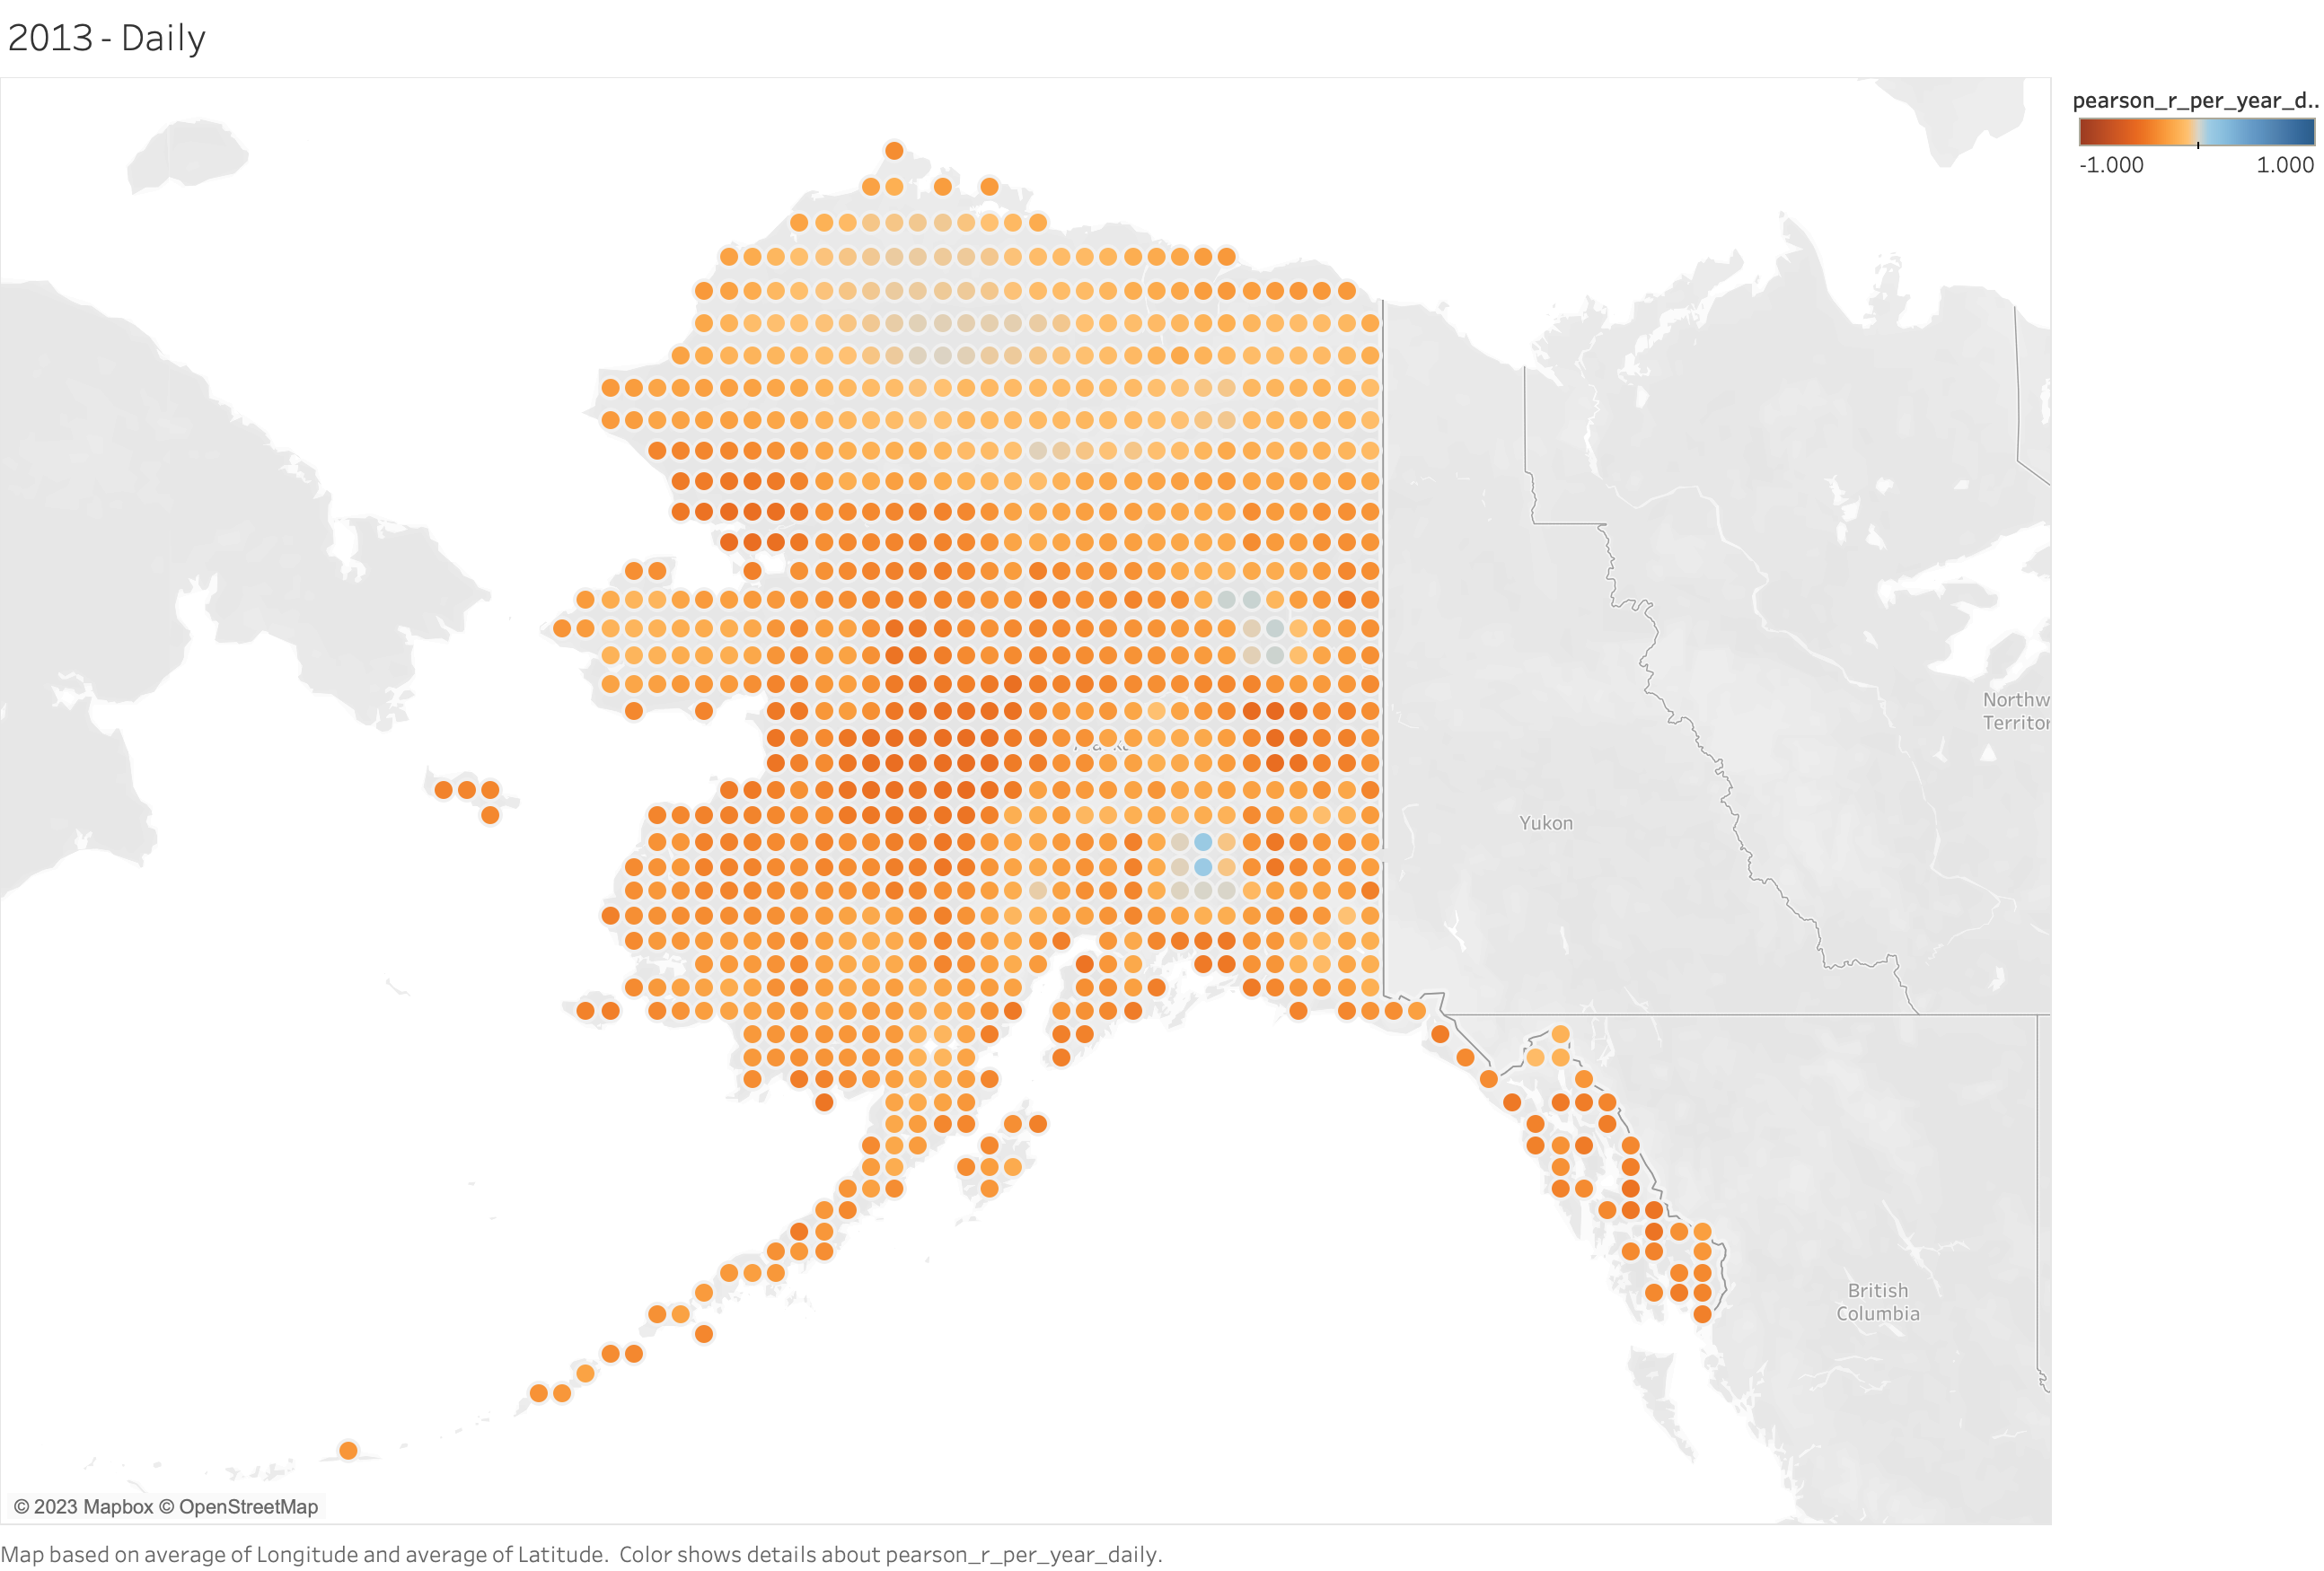
﻿-0.469994

Slide 27
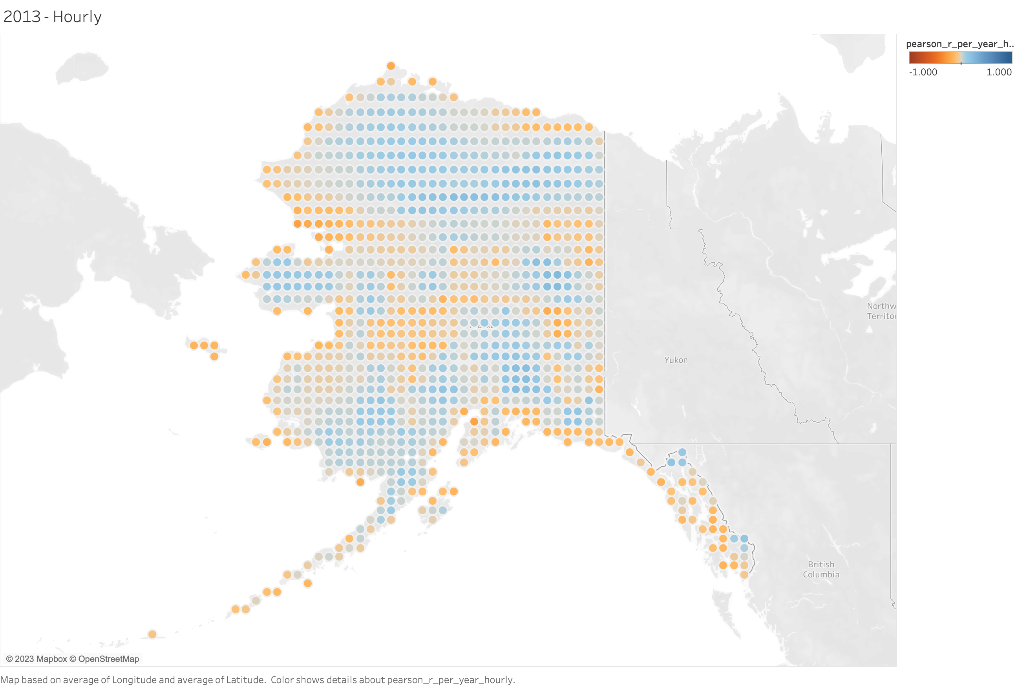
﻿-0.0701493

